Slide 1
ELE 635
Frequency Modulation
Spring 2015

Slide 2
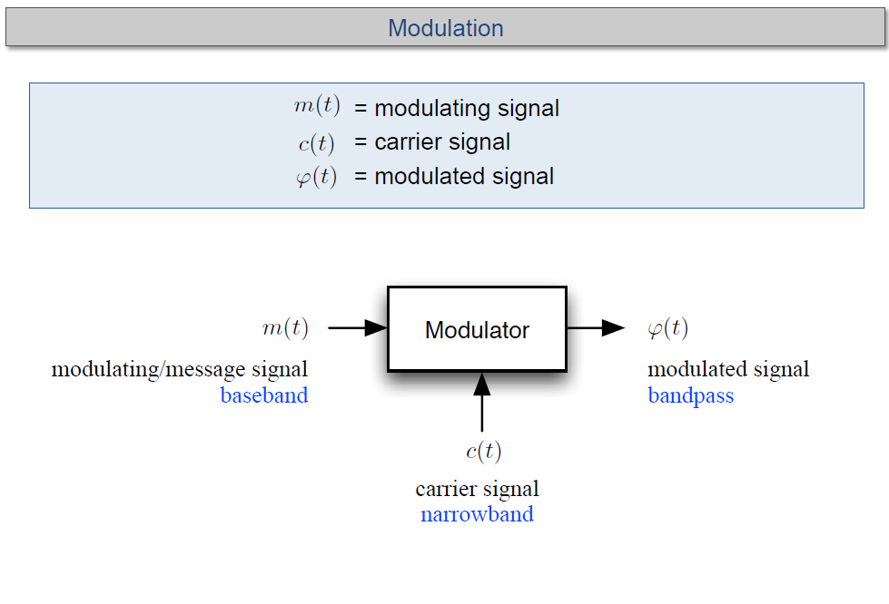

Slide 3
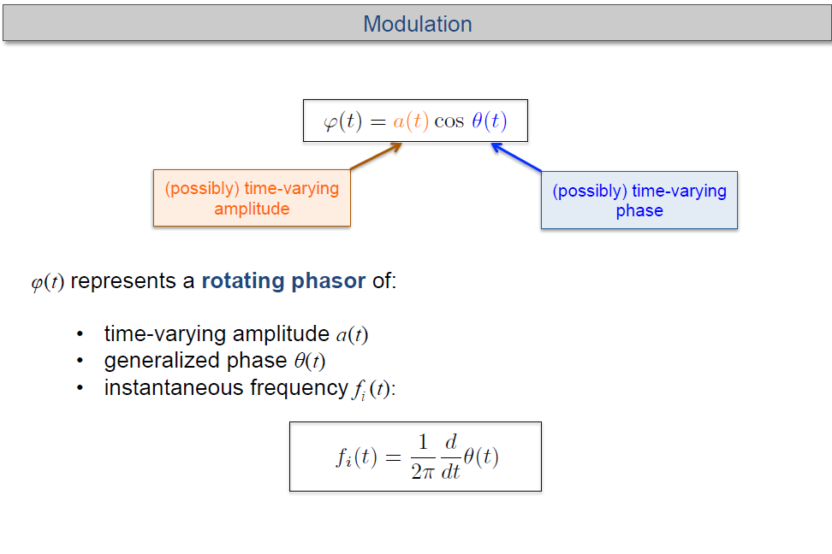
Frequency is rate of change of phase

Slide 4
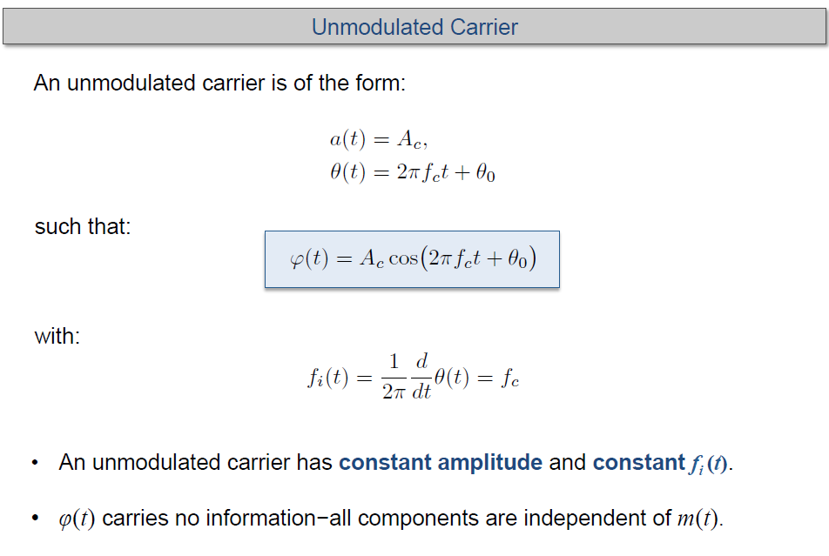
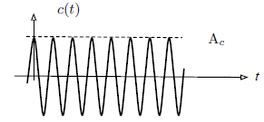

Slide 5
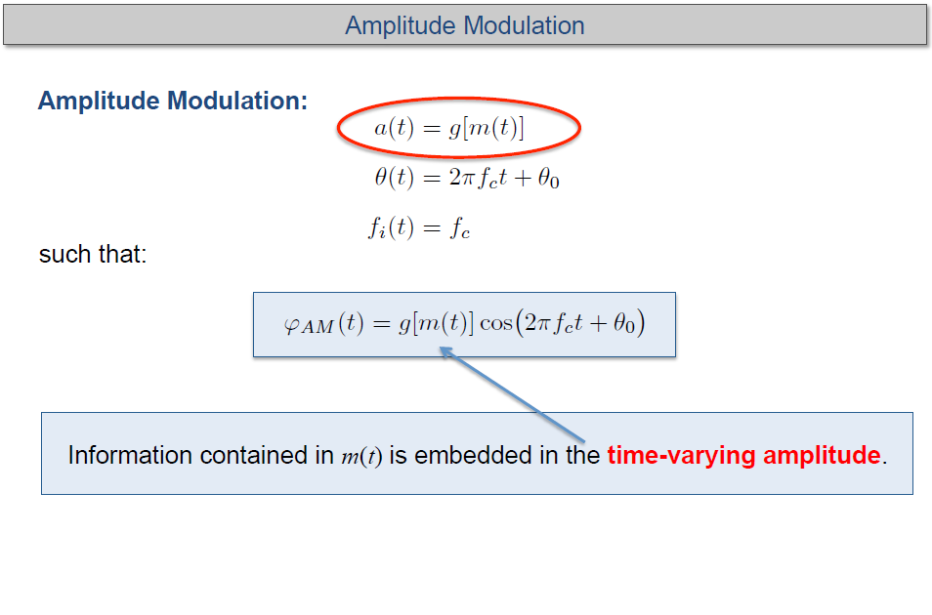
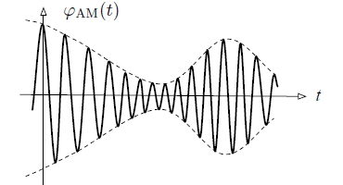

Slide 6
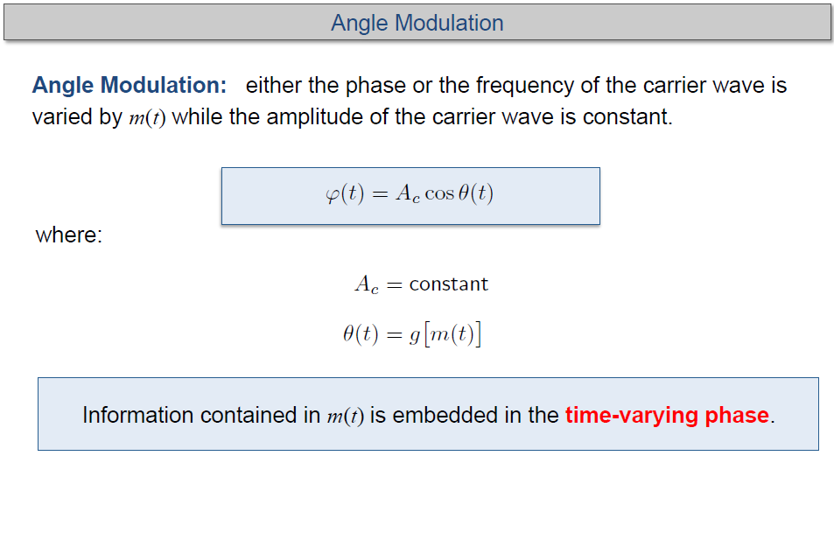

Slide 7
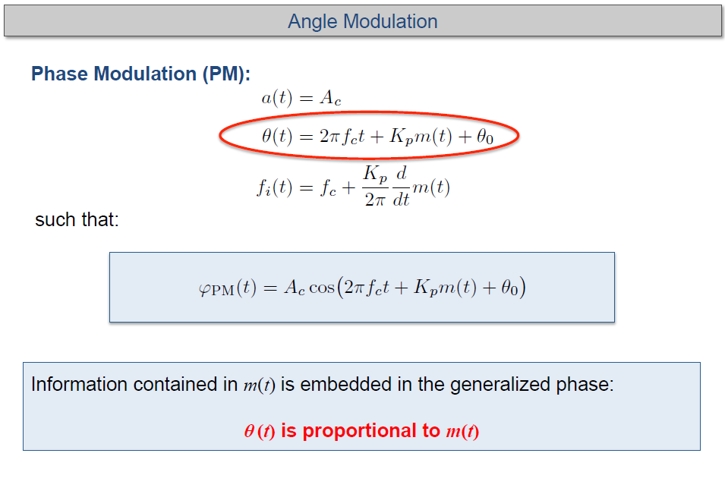
Phase Angle

Slide 8
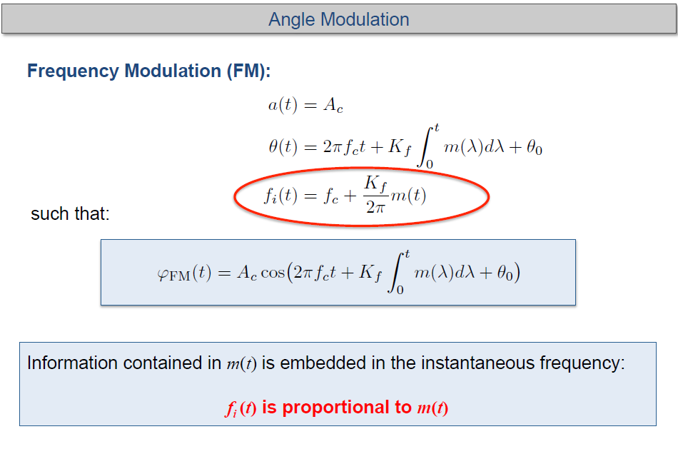

Slide 9
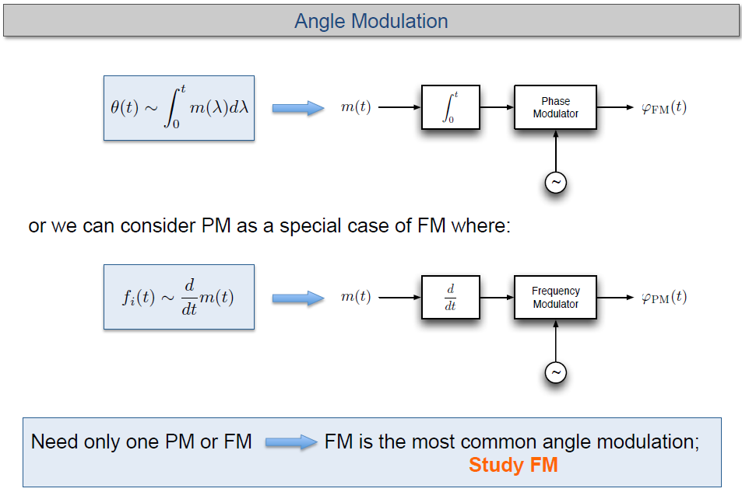
PM and FM are closely related.
Enough to focus only on one scheme: FM

Slide 10
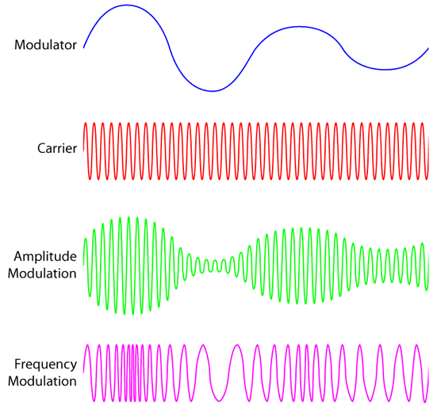
Modulating
Signal
Arbitrary waveform
Constant Amplitude and
Frequency
Varying Amplitude
Varying Frequency
http://global.oup.com/us/companion.websites/fdscontent/uscompanion/us/static/companion.websites/9780199922963/images/AM_FM.gif

Slide 11
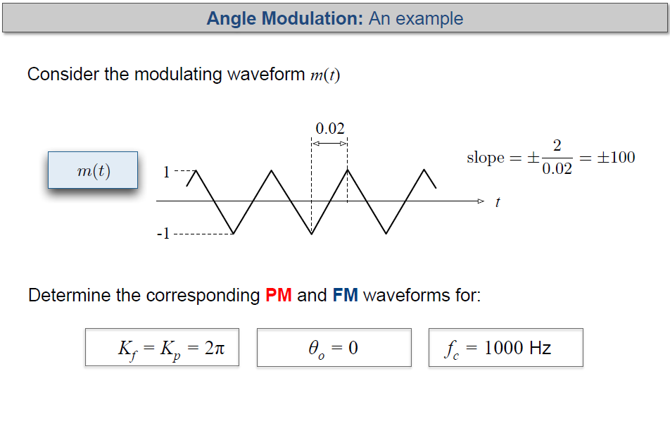

Slide 12
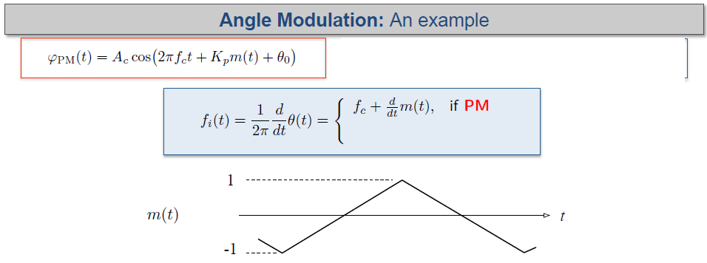
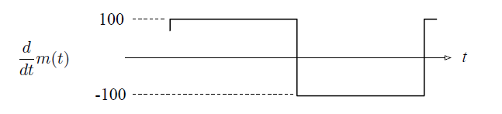
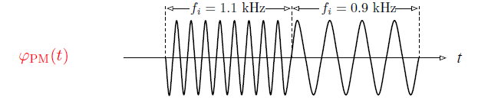

Slide 13
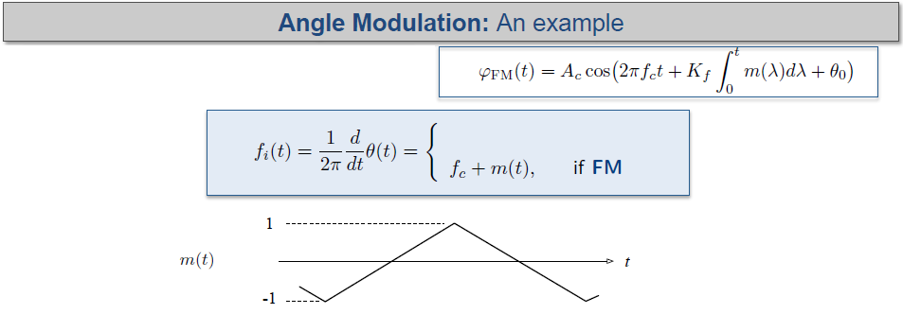
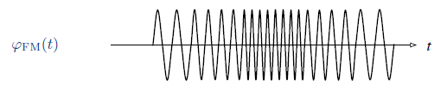

Frequency varies according to the amplitude of m(t)
Frequency varies according to the slope of m(t)

Slide 14
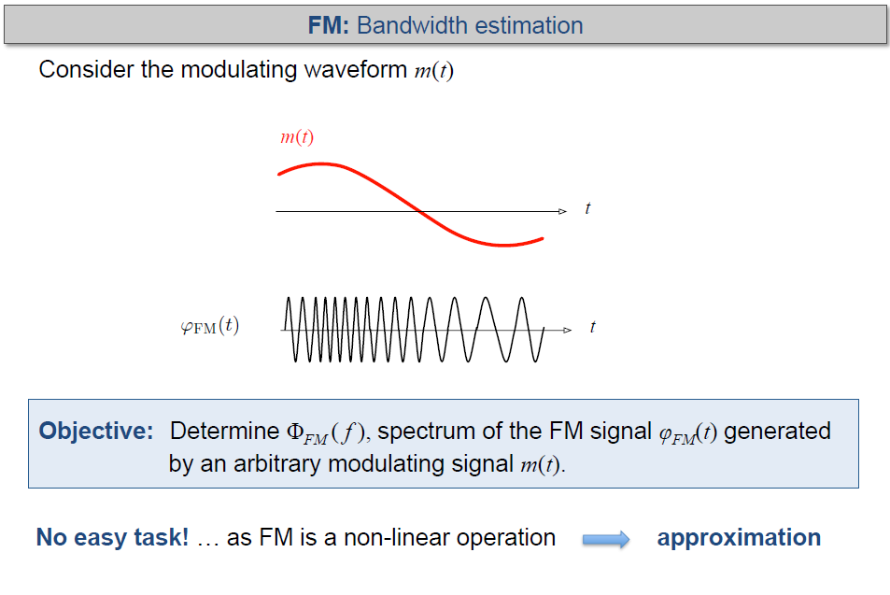
Arbitrary m(t)

Slide 15
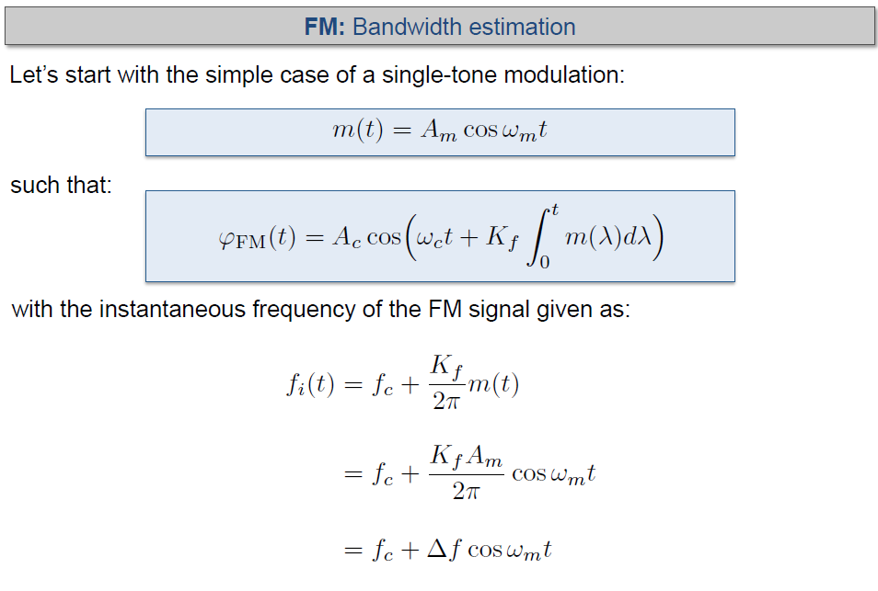
Maximum Frequency
Deviation

Slide 16
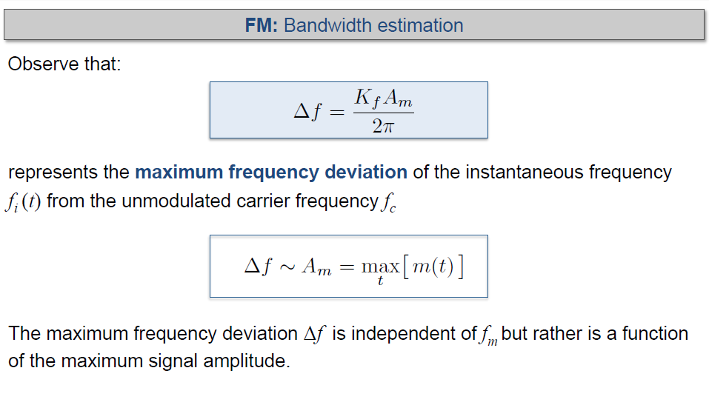

Ex: A 1 MHz carrier is frequency modulated with a 1 kHz tone. A_{m}= 2.
$$K_{f}=2π×{10}^{3}$$
Find the maximum and minimum frequencies of the FM signal. Repeat for f_{m} = 2 kHz.

Slide 17
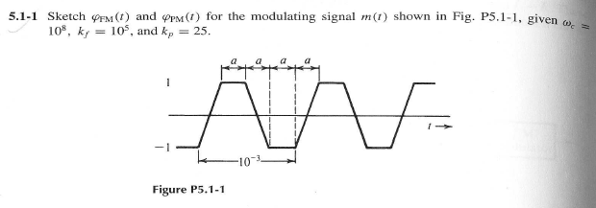



Example:
$$K_{f}=2π×{10}^{5}$$
$f_{c}={10}^{7}$ Hz
a = 10⁻³/4;
Slope = 2/a = 8000
$$K_{p}=50π$$

Slide 18
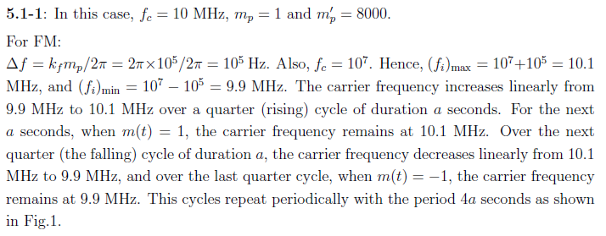
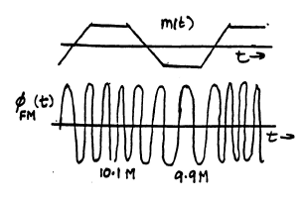
10⁻³

Slide 19
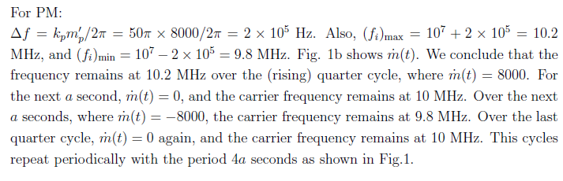
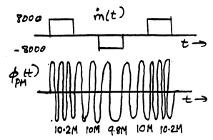

Slide 20
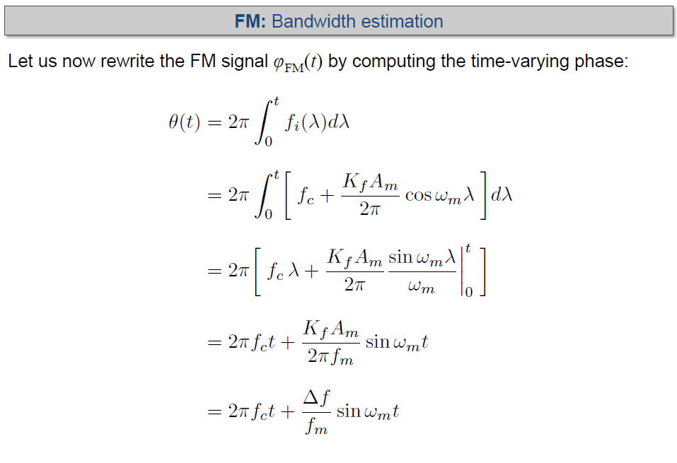
* Tone Modulation

Slide 21
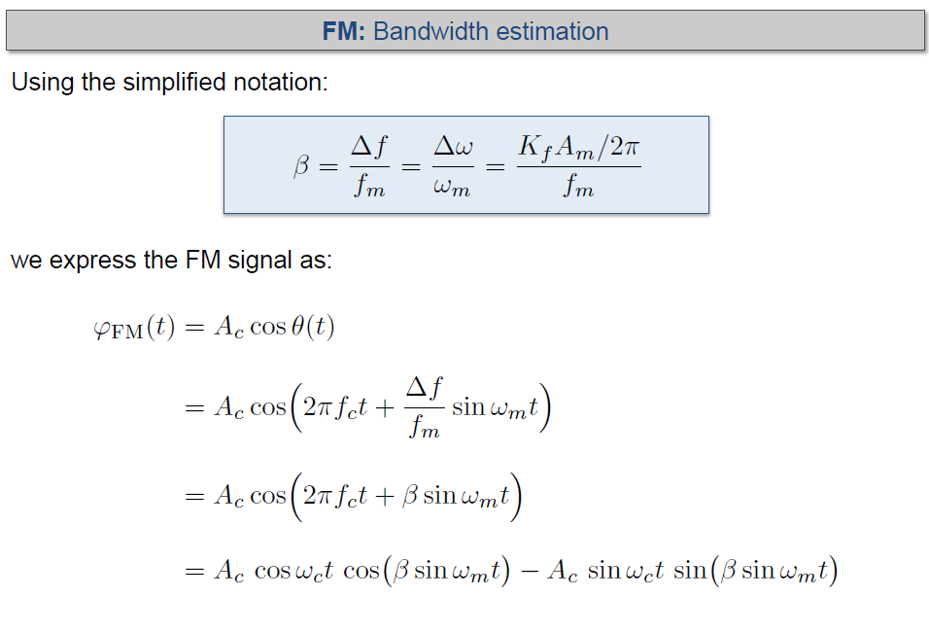

Ex: Find β in the previous example
For f_{m} = 1 kHz and f_{m} = 2 kHz; A_{m}= 2
$$K_{f}=2π×{10}^{3}$$

Slide 22
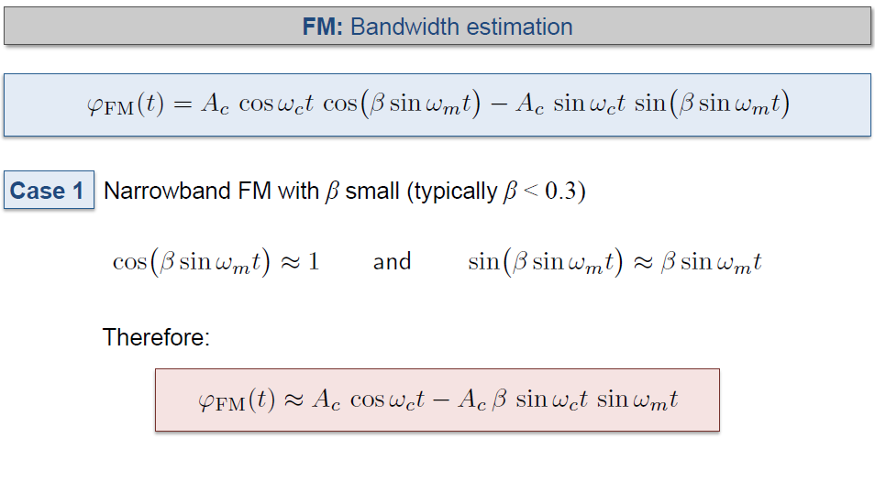
Carrier
Modulating
Tone

Slide 23
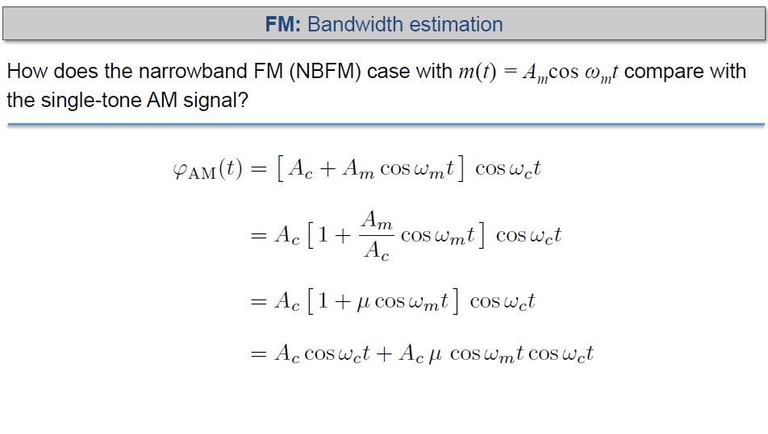



Slide 24
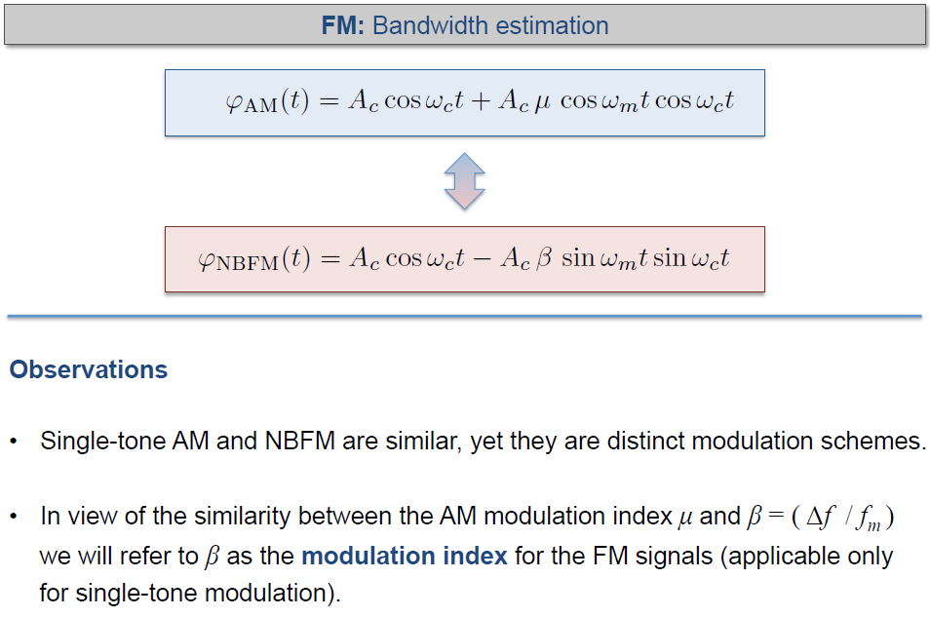

Slide 25
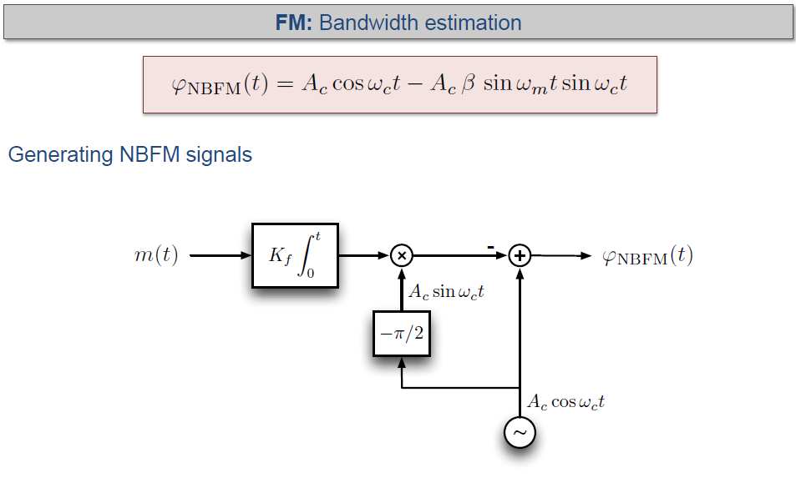

Tone modulation
General Expression

Slide 26
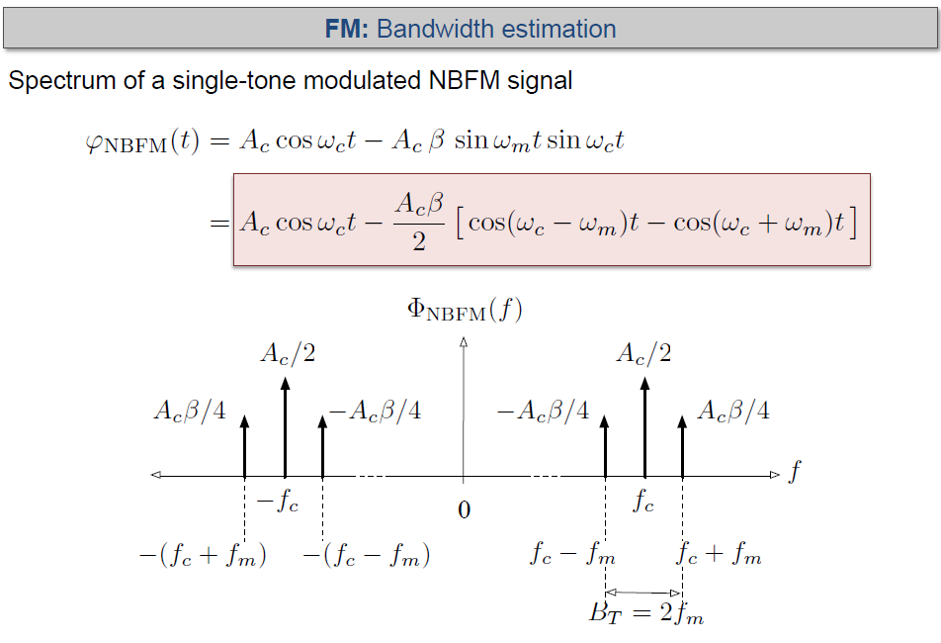
Same as AM

Slide 27

Example:
A NBFM tone modulated signal has 1 MHz carrier frequency and A_{c}= 4.
The modulating tone has 8 kHz frequency and A_{m}= 2.
a) Sketch the spectrum of the NBFM signal, indicating amplitudes.
What is the transmission bandwidth?
b) What is the new sideband amplitude if A_{m} is changed to A_{m}= 4.
What is the new transmission bandwidth. Other values remain the same.
c) What is the new sideband amplitude if f_{m} is changed to 4 kHz while A_{m}= 2.
What is the new transmission bandwidth. Other values remain the same.
$$K_{f}=2π×{10}^{3}$$

Slide 28
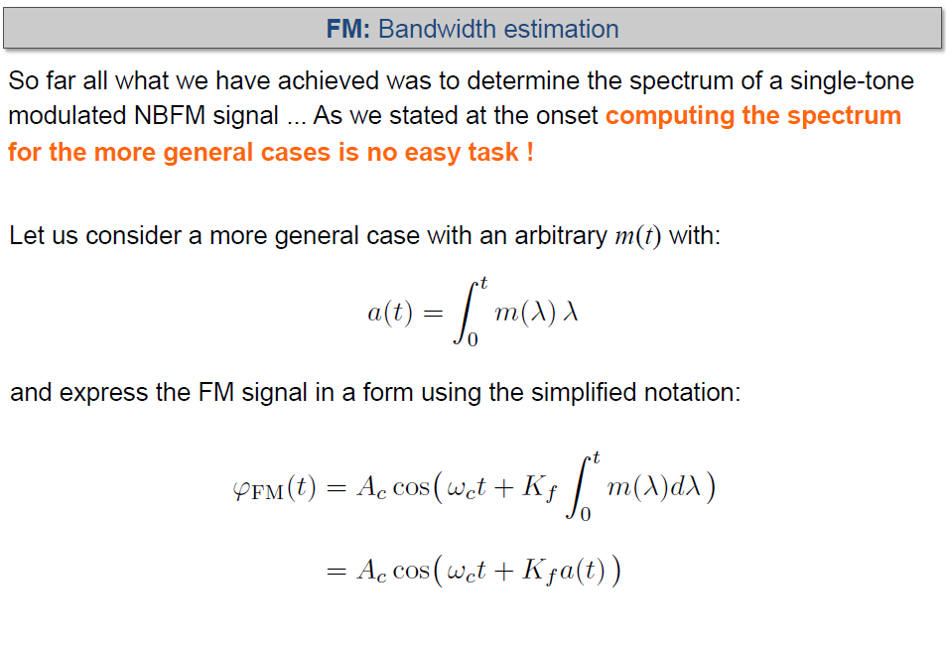

Slide 29
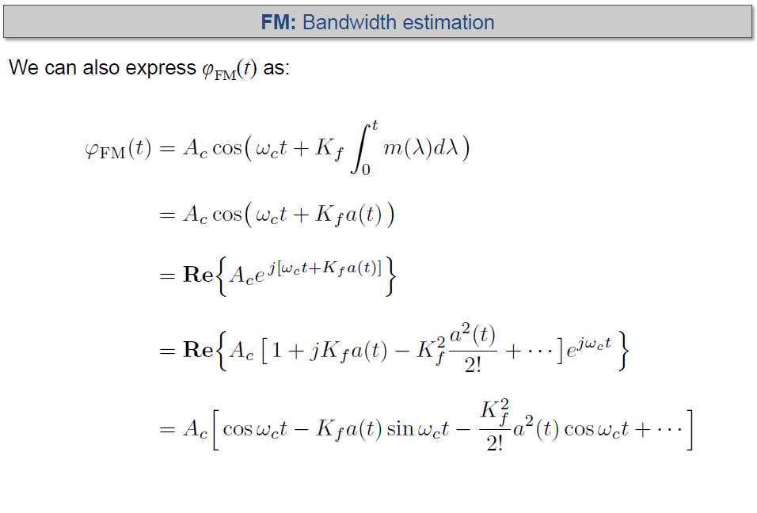

Slide 30
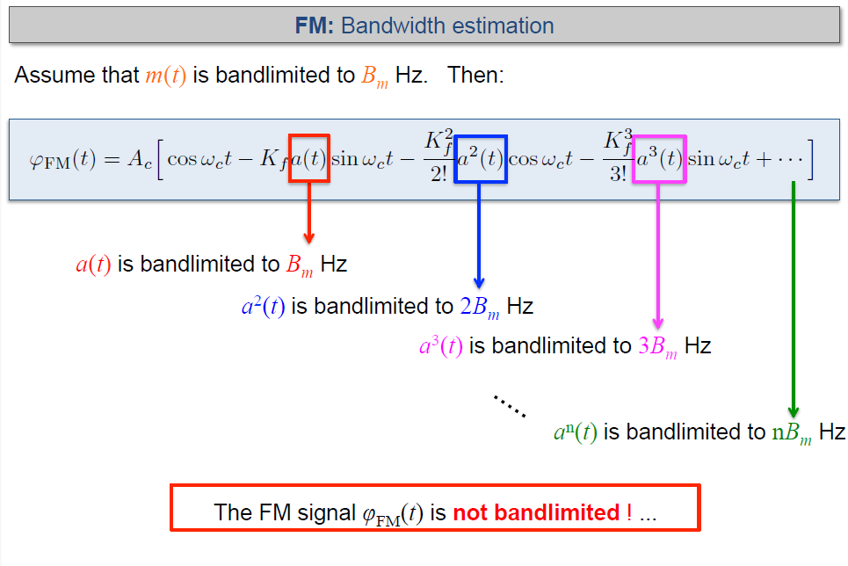

Slide 31
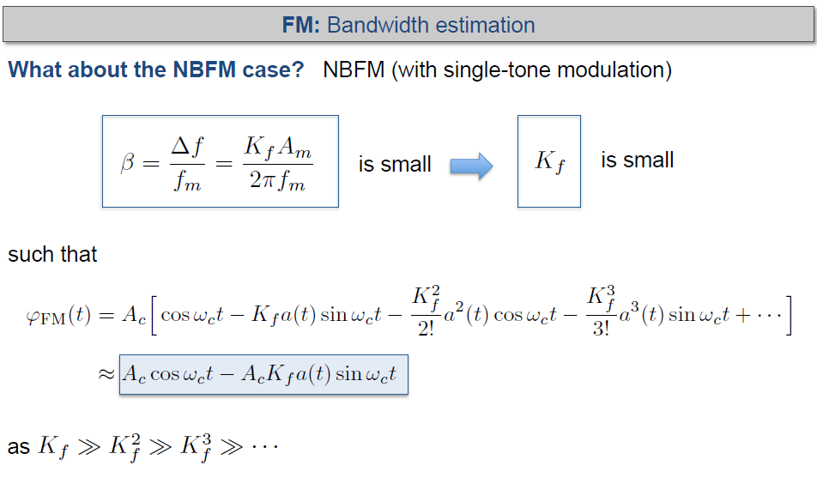

Slide 32
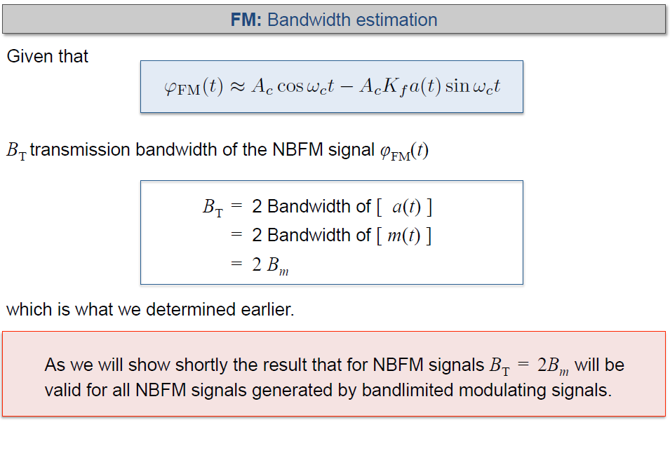

Slide 33
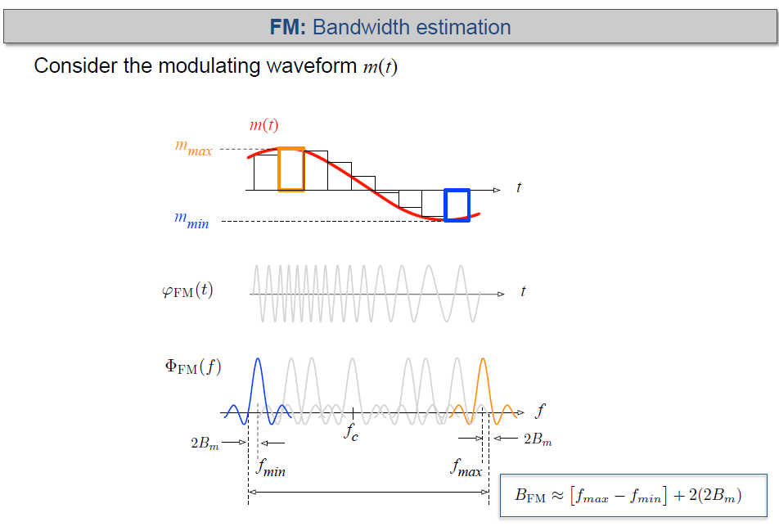

Slide 34
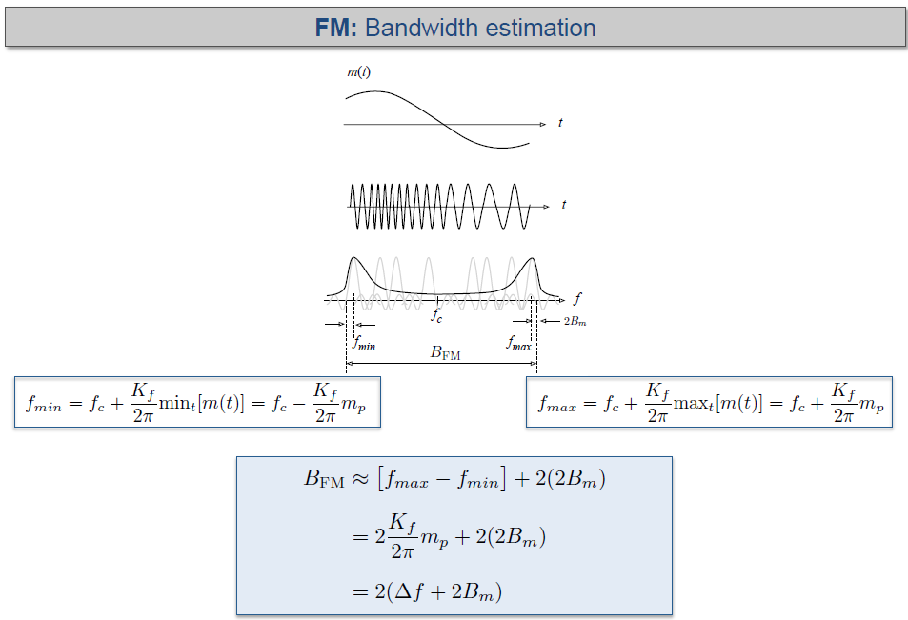

Slide 35
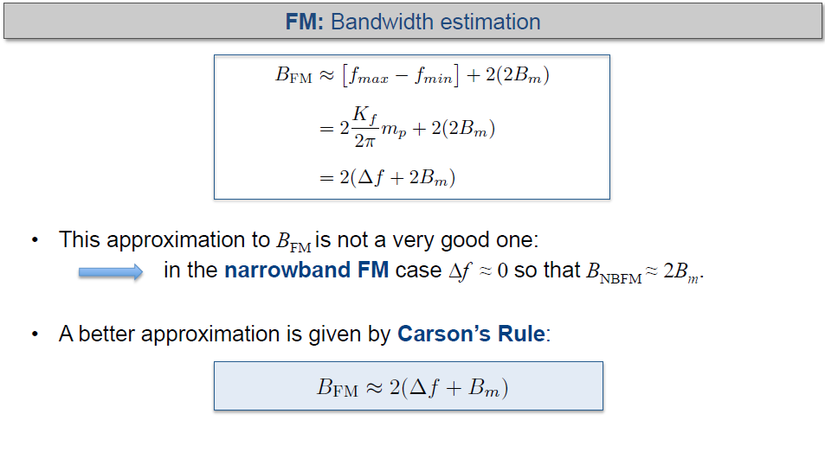

Slide 36
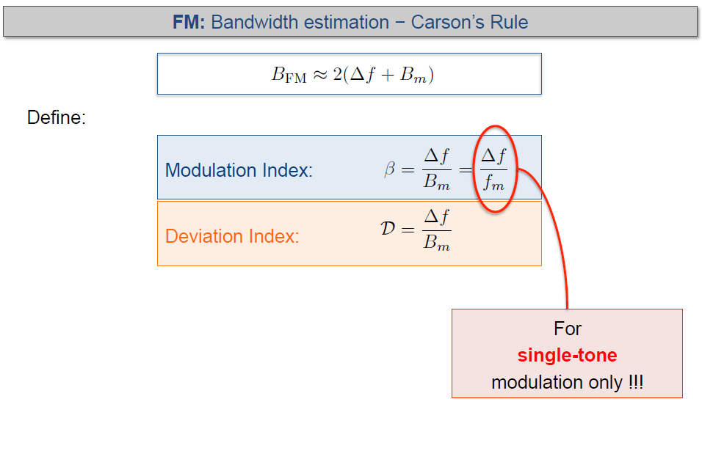
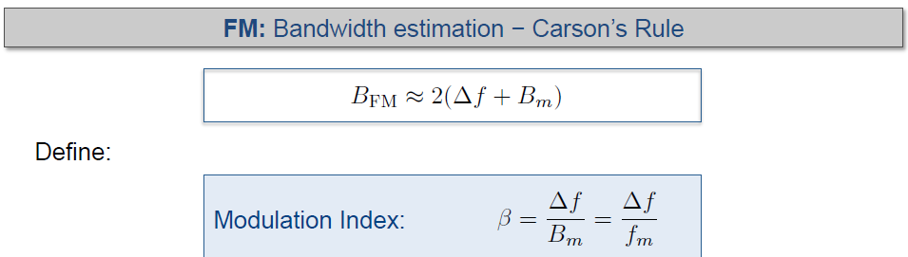

Where, f_{m} is the frequency of the modulating tone
Therefore, bandwidth of the FM signal is:

Slide 37
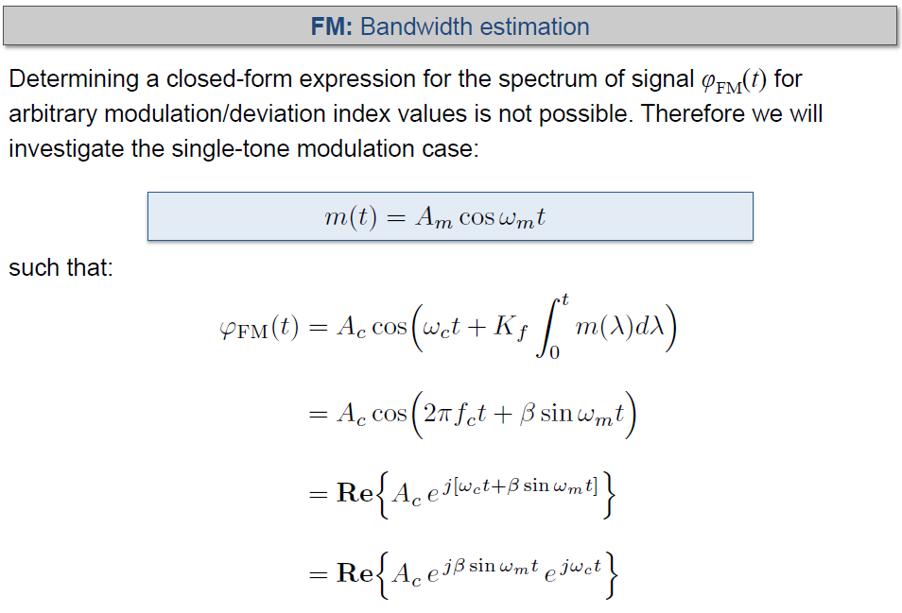

Slide 38
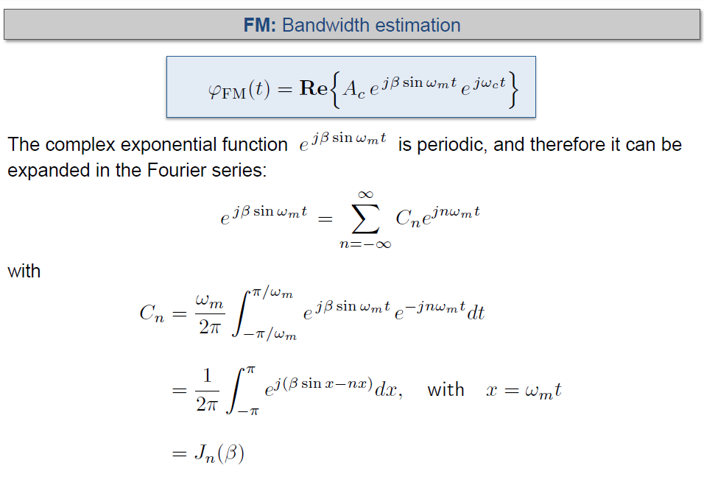

Slide 39
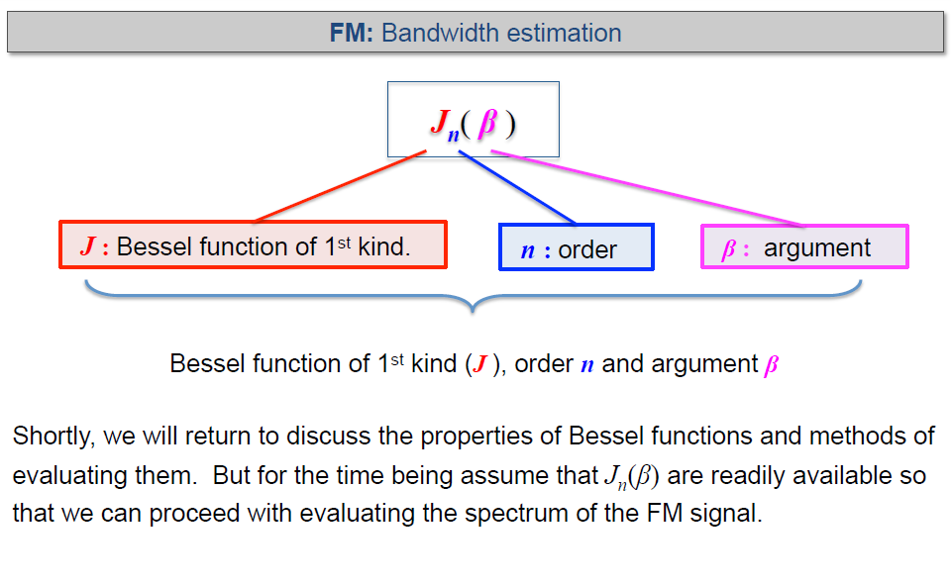

Slide 40
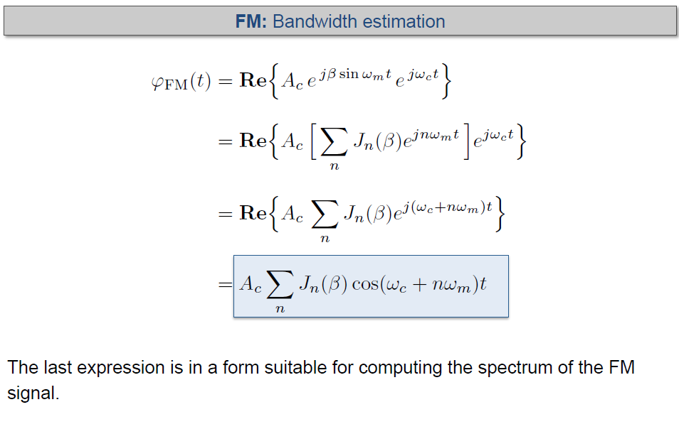

Slide 41
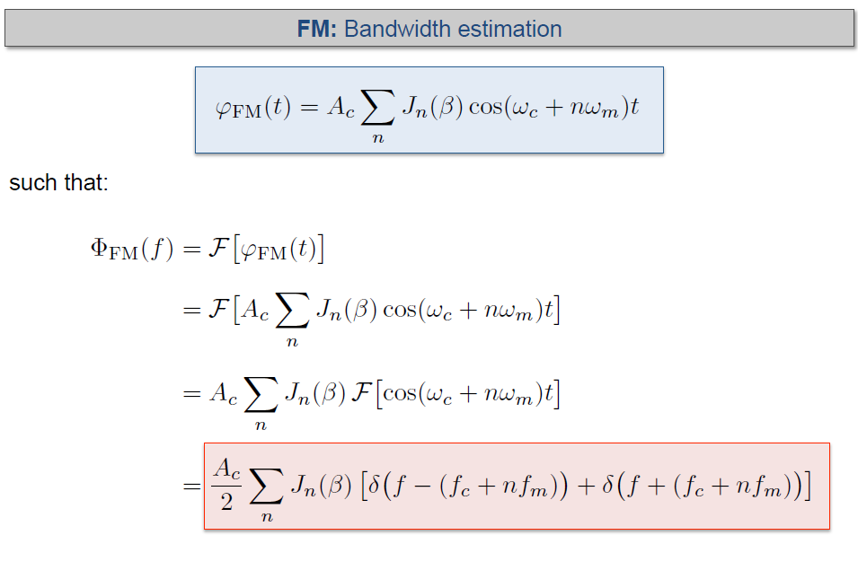

Slide 42
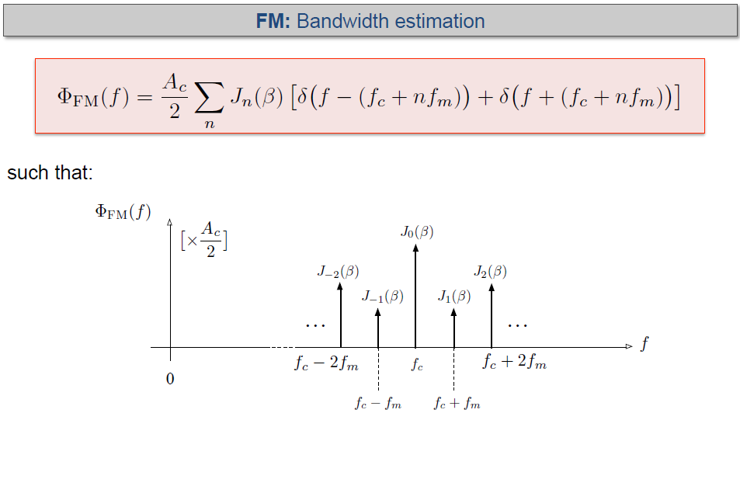
Remember this figure
This is the basis of FM

Slide 43
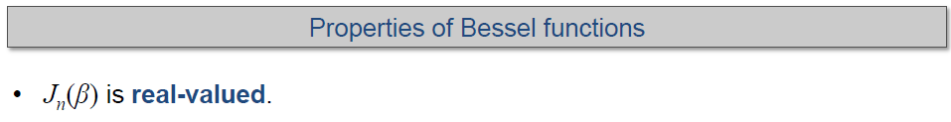

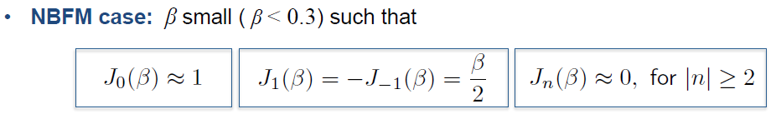


Slide 44


Slide 45




Slide 46




Slide 47



Slide 48




Slide 49


Slide 50

Transmission band width
≈ 2Δf
Spacing between spectral lines = f_{m}

Slide 51




/100

Slide 52


Slide 53

Exercise: Find number of significant sidebands if β = 3.0.

Slide 54

Exercise: Find number of significant sidebands if β = 3.0.

Slide 55


Slide 56





$$β$$
$$β$$

Slide 57


Slide 58





Slide 59


Slide 60


Slide 61


Slide 62




Slide 63



Slide 64


$$β$$

Slide 65


