Slide 1
ELE 635
Single Sideband Modulation
Spring 2015

Slide 2

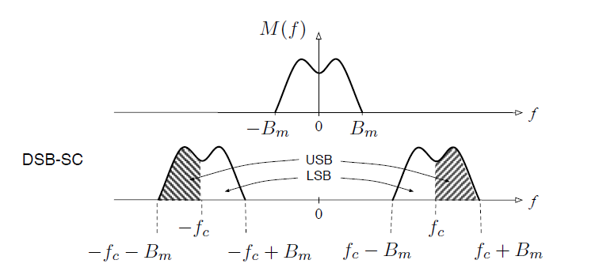
This is because transmitting both upper side band (USB) and lower side band (LSB)

Slide 3
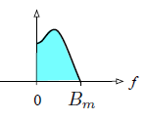

Real valued signals will result in spectrum with conjugate symmetry
An asymmetric spectrum will result in a complex signal.
Let us split M(f) into its USB and LSB components M₊(f) and M₋(f)
If, m₊(t) ←→ M₊(f) and m₋(t) ←→ M₊(f), then

Slide 4
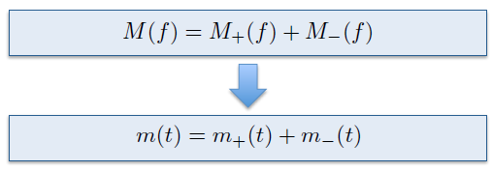

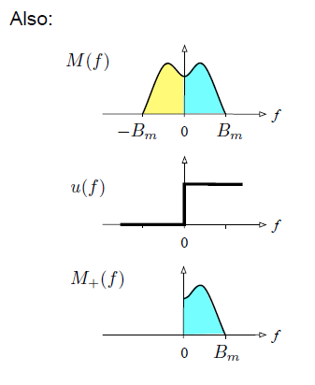

Here, m_{h}(t) and M_{h}(f) are the imaginary
Portions yet to be found

Slide 5
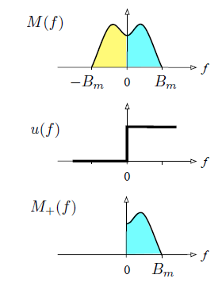

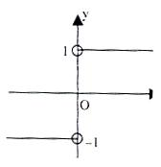
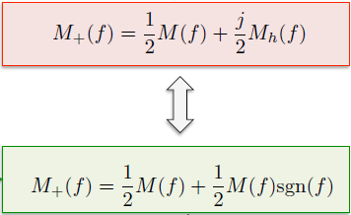
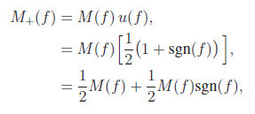
Therefore,

Slide 6



Here, H_{h}(f) is the transfer function of the Hilbert Filter defined by,

Slide 7
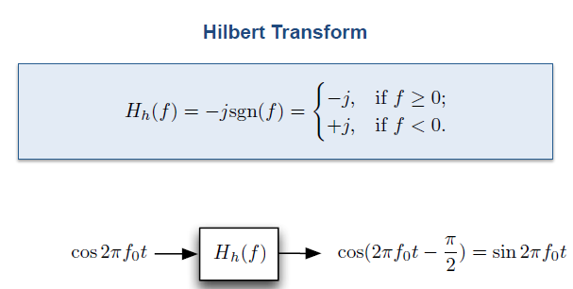
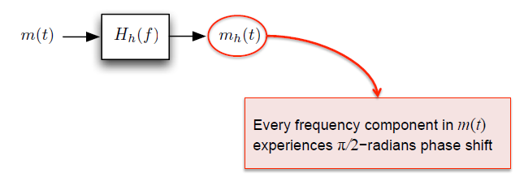

Slide 8
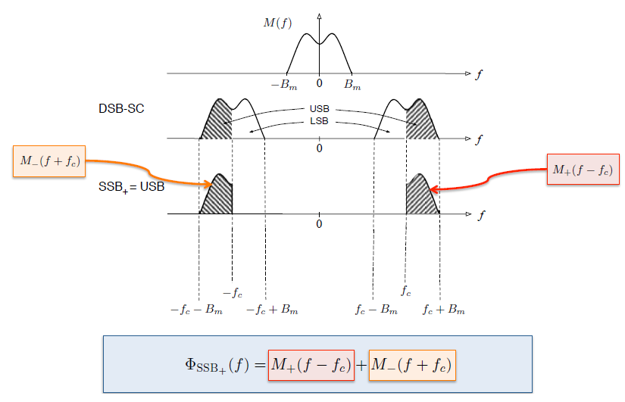
SSB Considering only the Upper Side Band

Slide 9



SSB Considering only the Lower Side Band

Slide 10
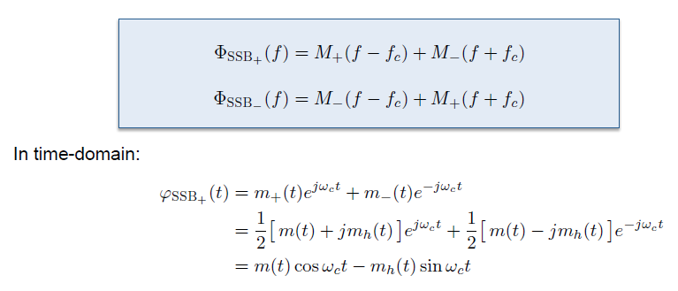

Note the passband SSB signals are real although m₊(t) and m_(t) are complex

Slide 11
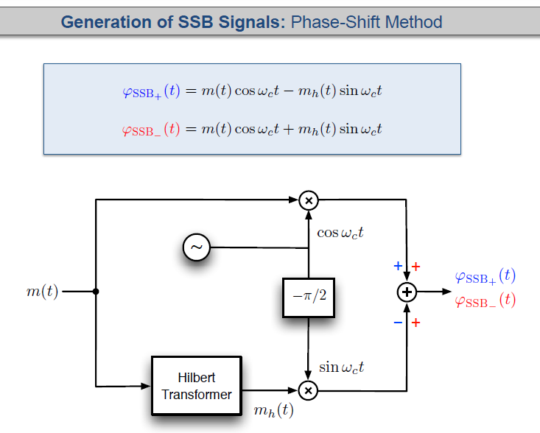
Compare with QAM
However, it may not be easy to design a wideband phase shifter that shifts the
Phase of every frequency component exactly by 90º

Slide 12
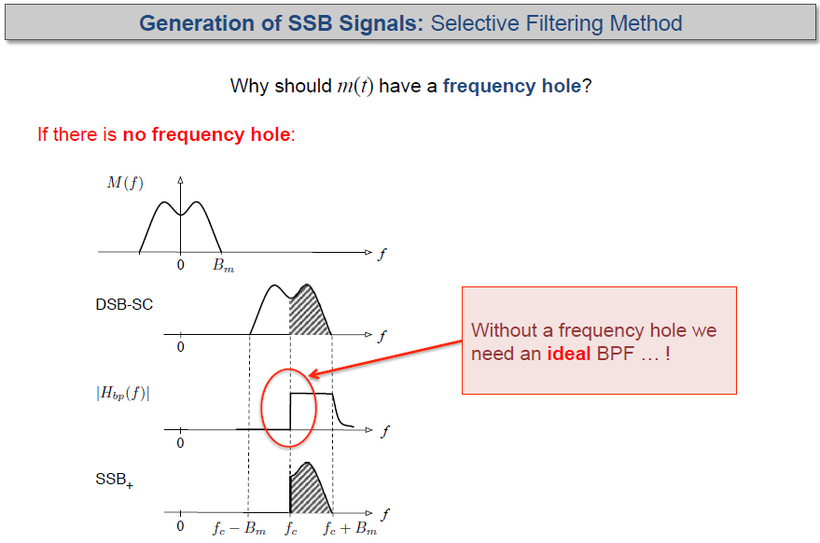

Slide 13
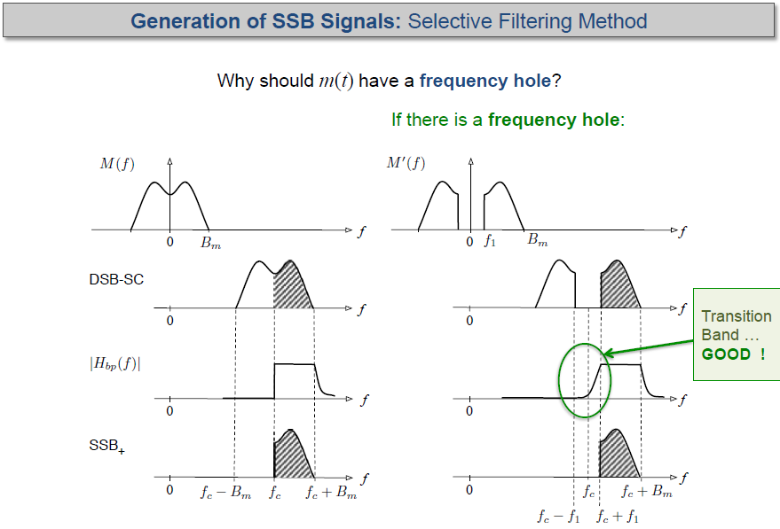

Slide 14
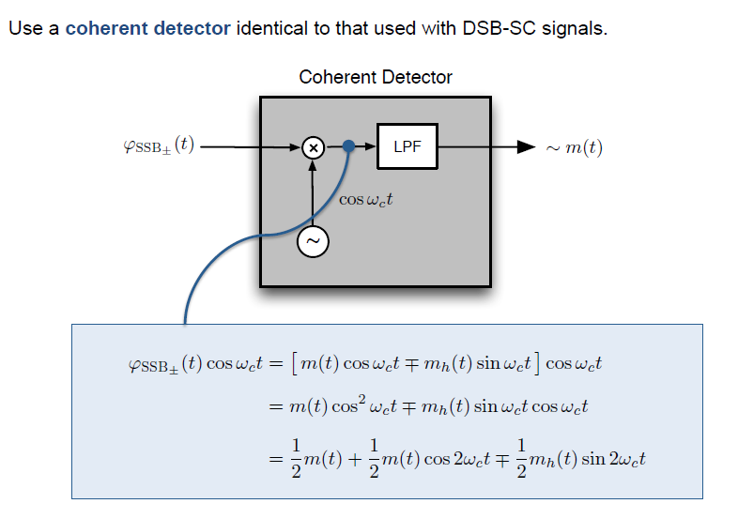
Demodulation of SSB Signal
Removed by LPF

Slide 15
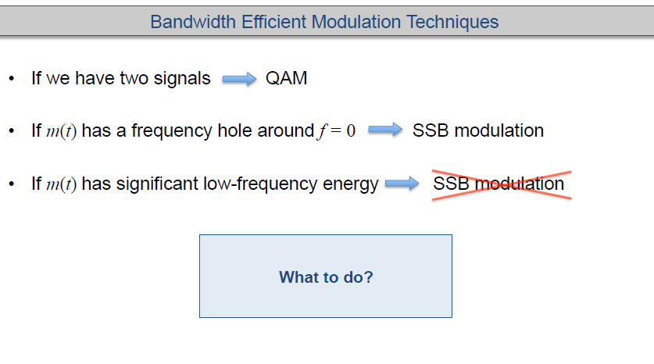

Slide 16
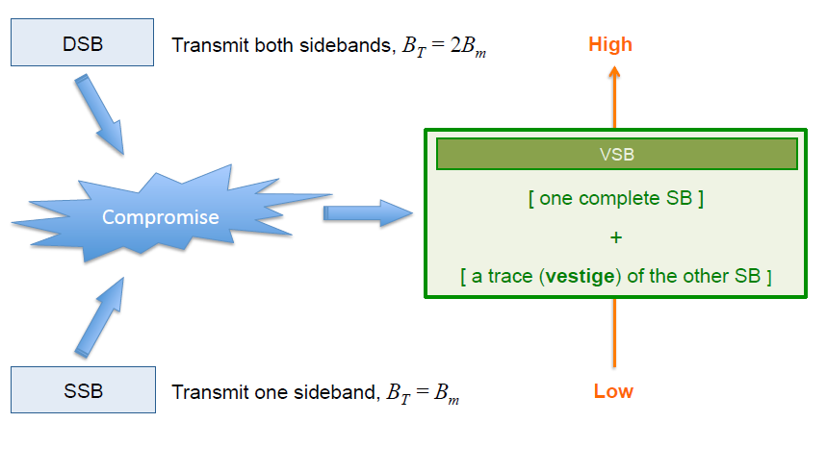

Slide 17
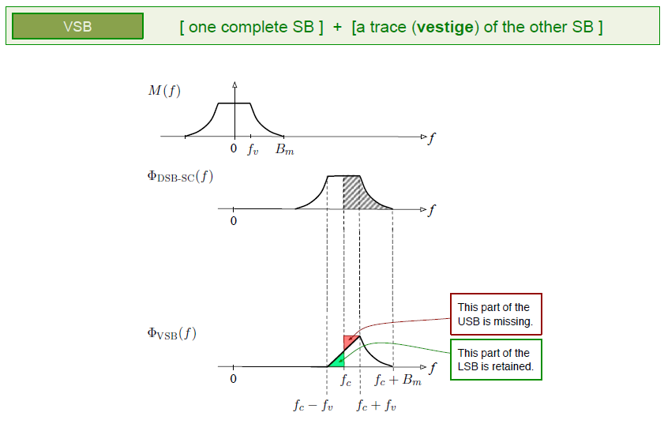

Slide 18
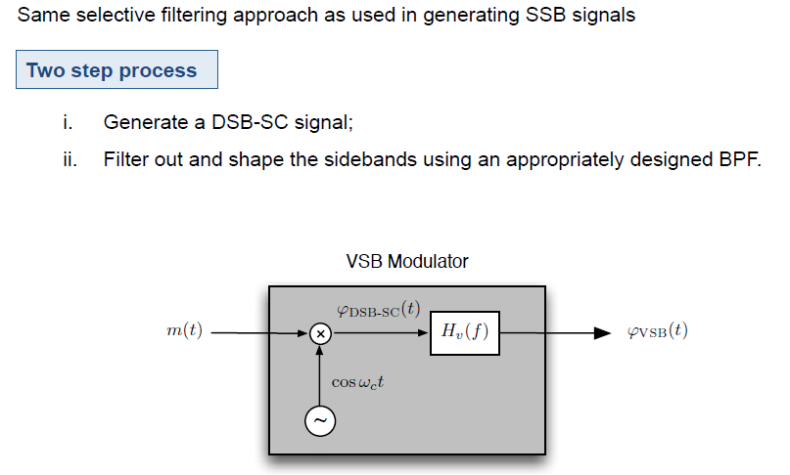
Generation of Vestigial Side Band Signal

Slide 19
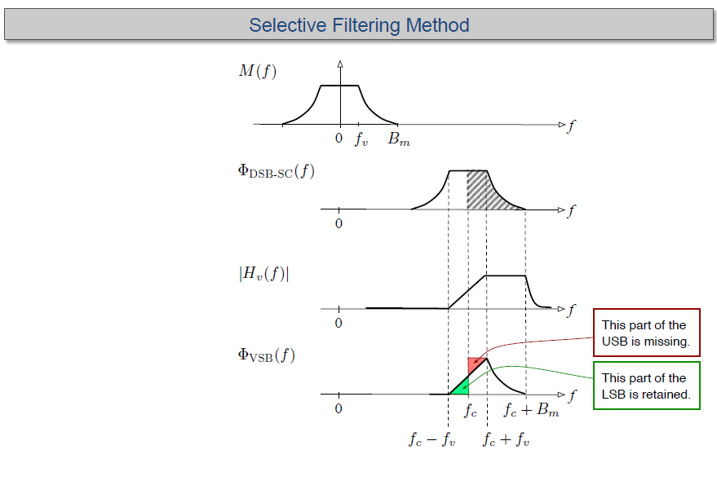
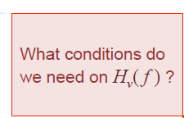
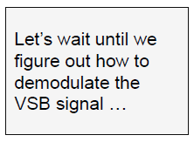

Slide 20
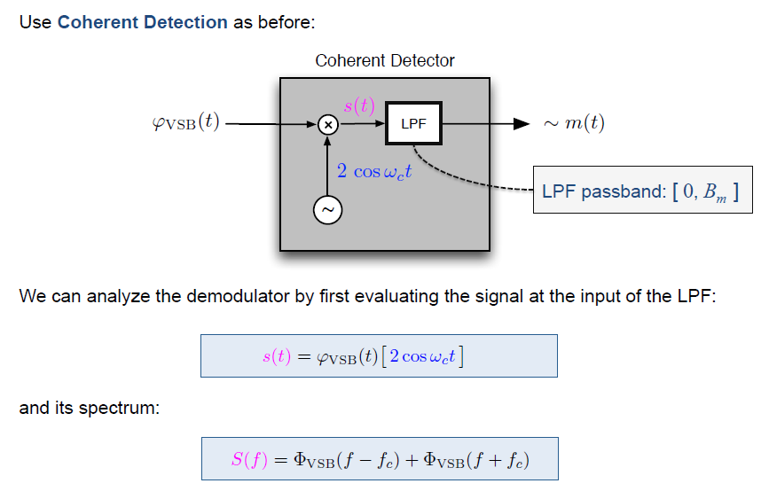

Slide 21
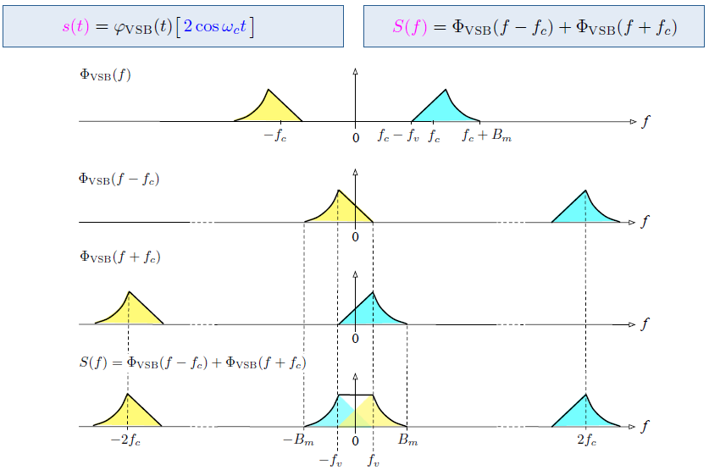

Slide 22
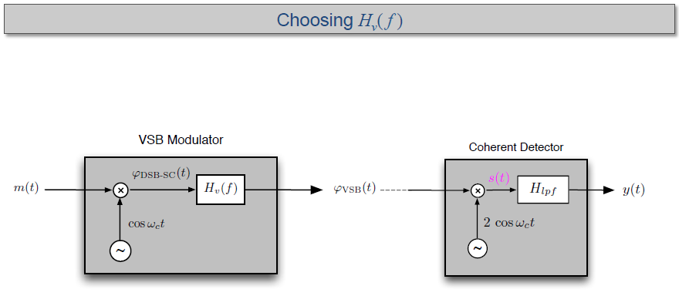




Slide 23

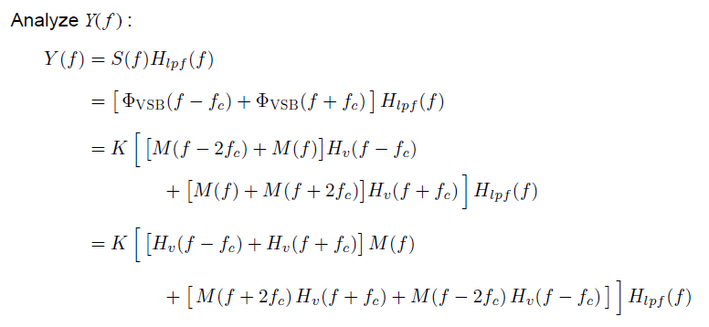

Slide 24
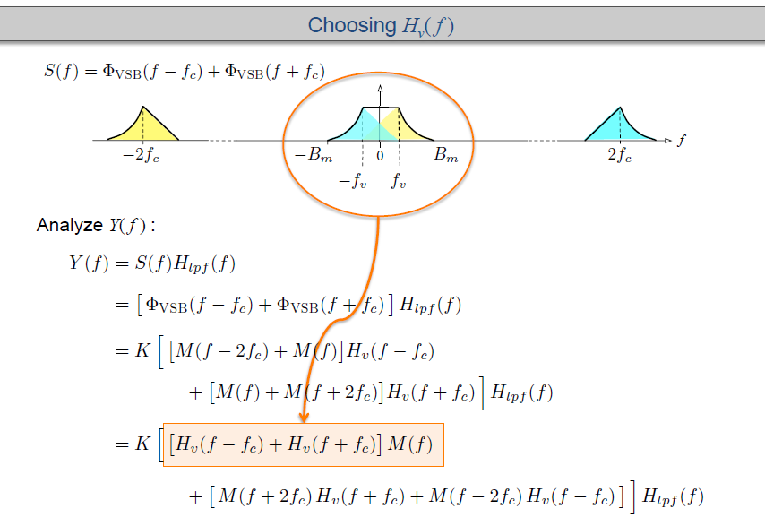

Slide 25
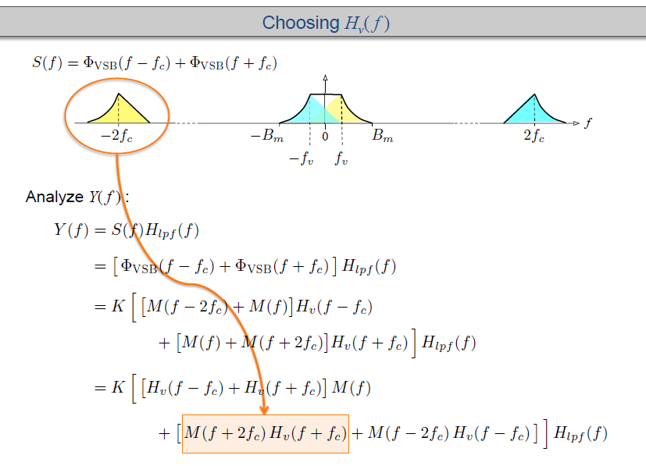

Slide 26
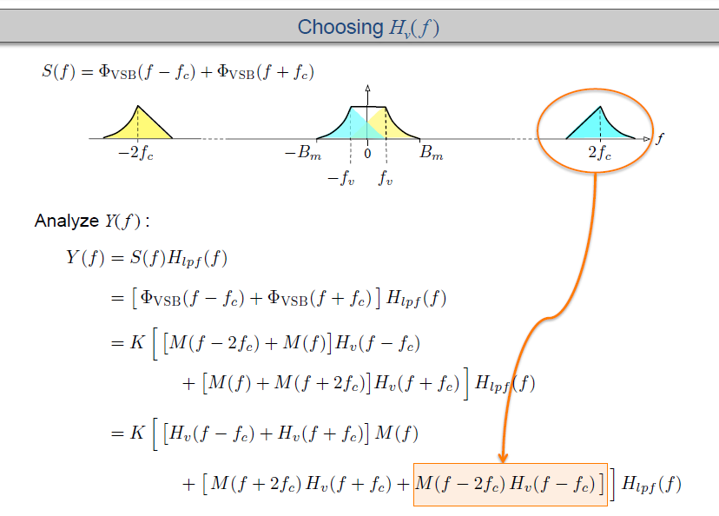

Slide 27
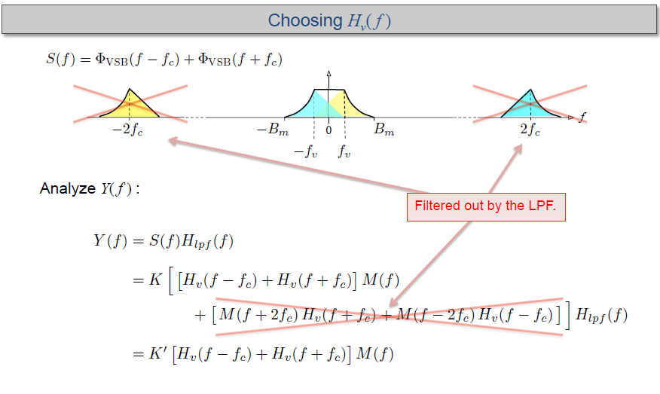


Slide 28
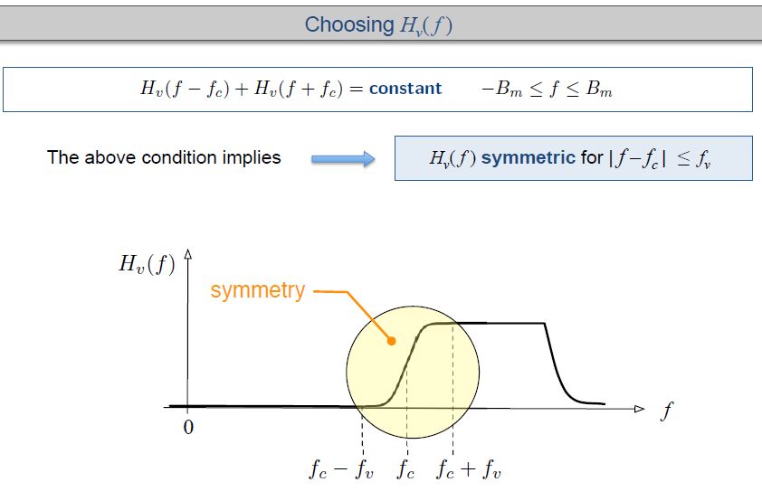

Slide 29




Slide 30
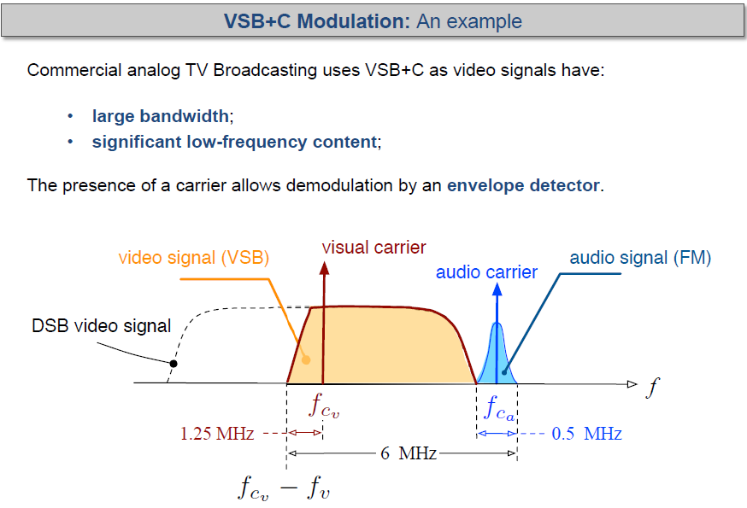

Slide 31
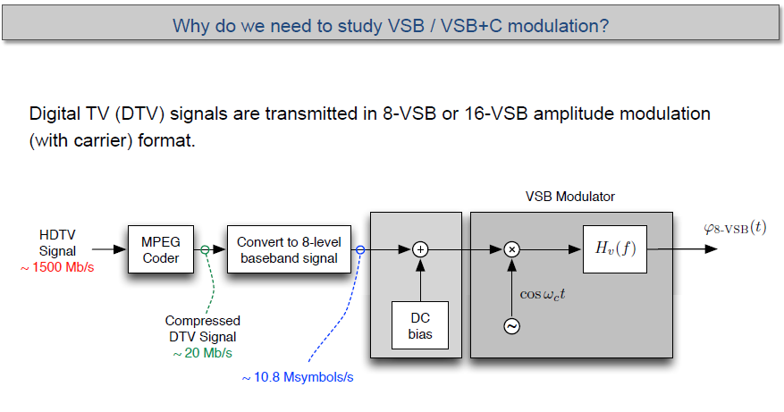

Slide 32
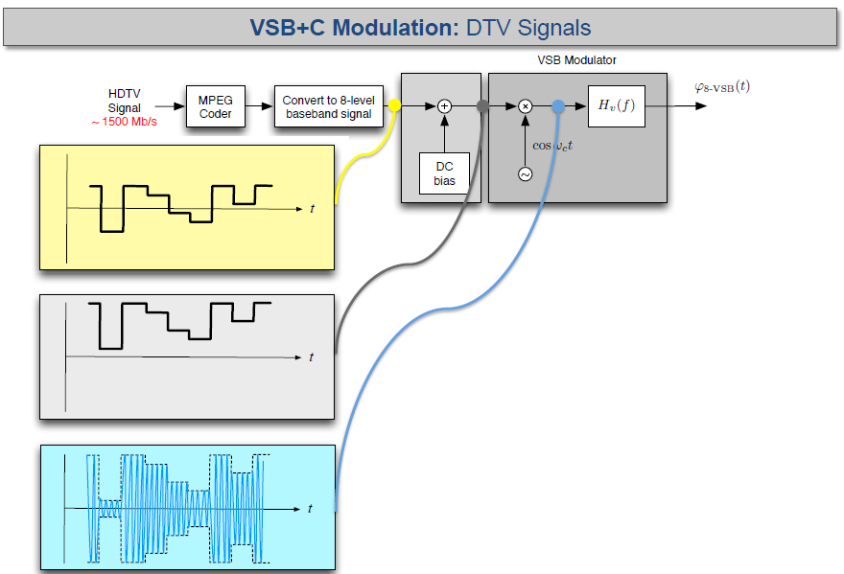

Slide 33
