Slide 1
ELE 635 Chapter 3
Analysis and Transmission of Signals
Xavier Fernando
Spring 2015

Slide 2
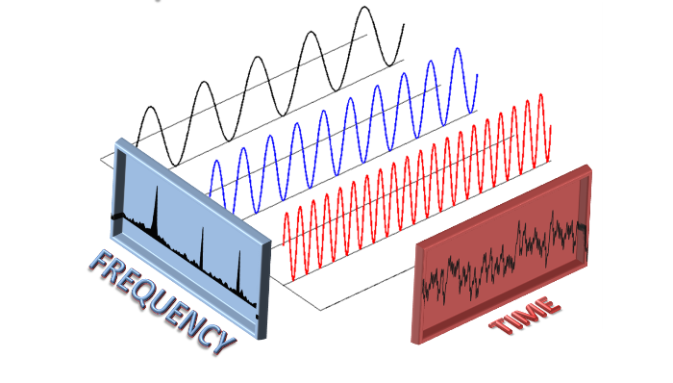
Frequency and Time Domains
Certain aspects are better observed in the time domain using Oscilloscope.
Some other aspects are better observed in the frequency domain using Spectrum Analyser.
Fourier techniques provide tools to go back and forth.

Slide 3
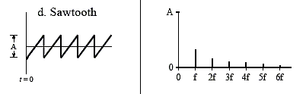
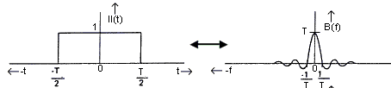
Fourier Analysis
Periodic signals have a fundamental frequency and it harmonics.
Fourier series is used analyze periodic signals.
Fourier Transform is defined for Energy Signals
Discrete
Spectrum
Periodic
Waveform
Energy
Signal
Continuous
Spectrum

Slide 4
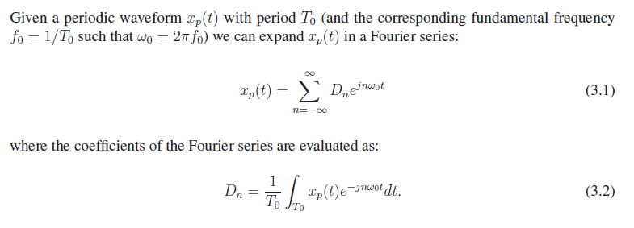
Fourier Analysis
Exponential Fourier Series is the most comprehensive way of looking at periodic signals.

Slide 5
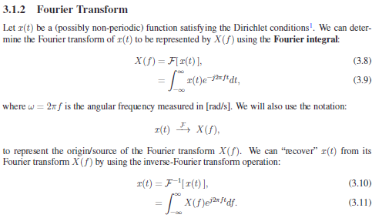
Fourier Transform

Slide 6
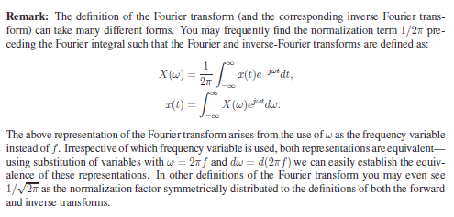
Alternative definition

Slide 7
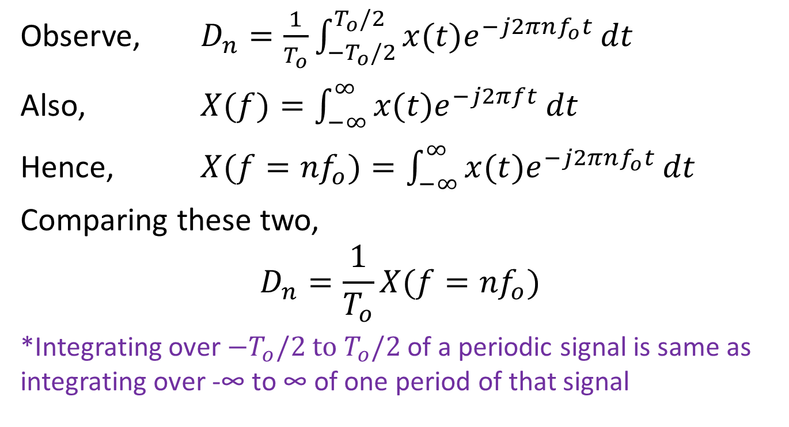
Fourier Series for Fourier Transform
Observe, $D_{n}=\frac{1}{T_{o}}\int_{{−T}_{o}/2}^{T_{o}/2}{x(t)e^{−j2πnf_{o}t}}dt$
Also, $X(f)=\int_{−∞}^{∞}{x(t)e^{−j2πft}}dt$
Hence, $X(f={nf}_{o})=\int_{−∞}^{∞}{x(t)e^{−j2πnf_{o}t}}dt$
Comparing these two,
$$D_{n}=\frac{1}{T_{o}}X(f={nf}_{o})$$
*Integrating over $−T_{o}/2$ $to T_{o}/2$ of a periodic signal is same as integrating over -∞ to ∞ of one period of that signal

Slide 8
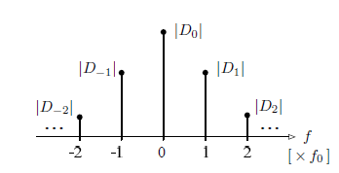

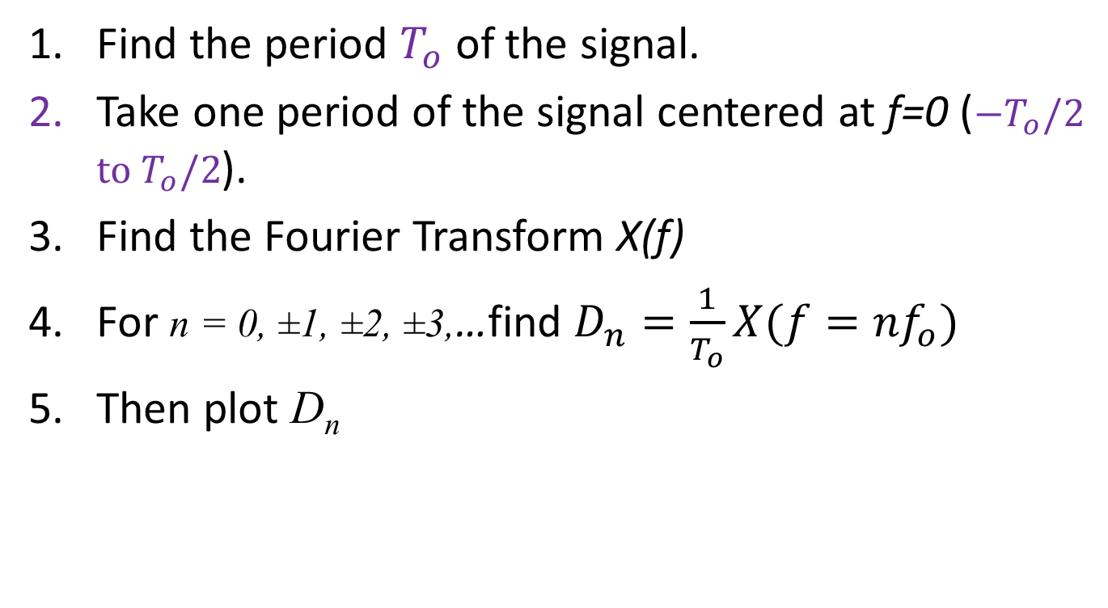
Fourier Series for Fourier Transform
Find the period $T_{o}$ of the signal.
Take one period of the signal centered at f=0 ($−T_{o}/2$ $to T_{o}/2$).
Find the Fourier Transform X(f)
For n = 0, ±1, ±2, ±3,…find $D_{n}=\frac{1}{T_{o}}X(f={nf}_{o})$
Then plot D_{n}
**D_{n} exists for only discrete values of f = nf_{o}

Slide 9
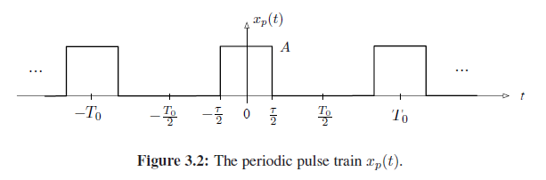
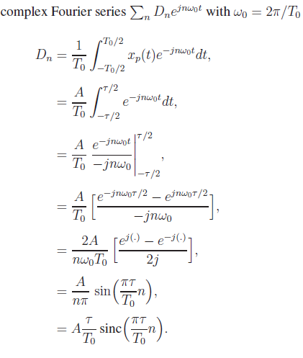

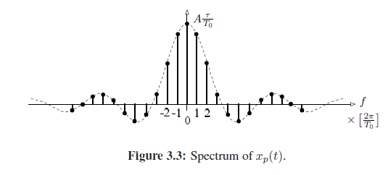
Fourier
Analysis

Slide 11
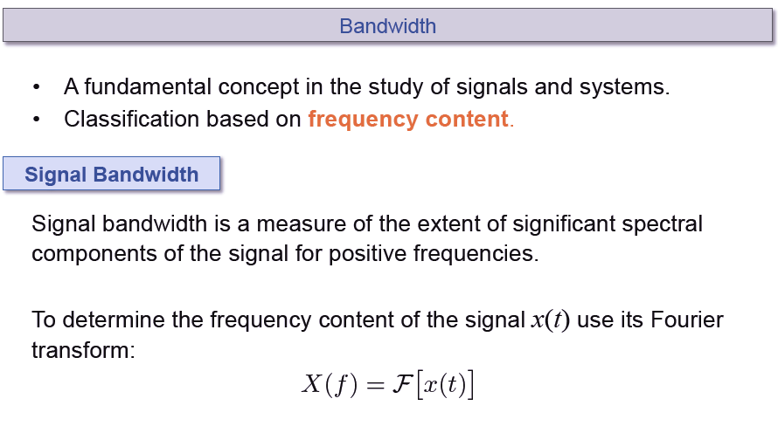

Slide 12
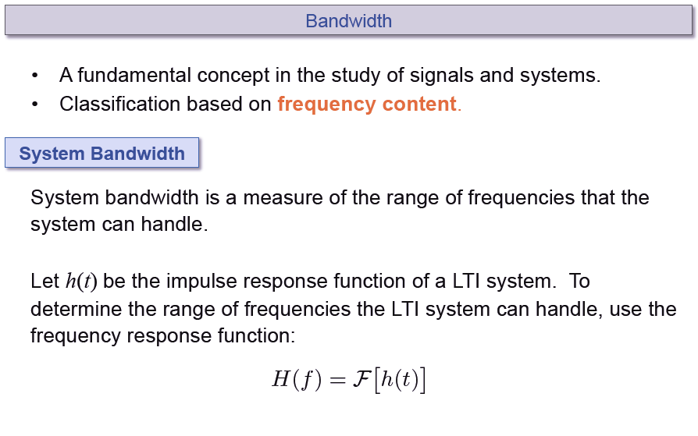

Slide 13
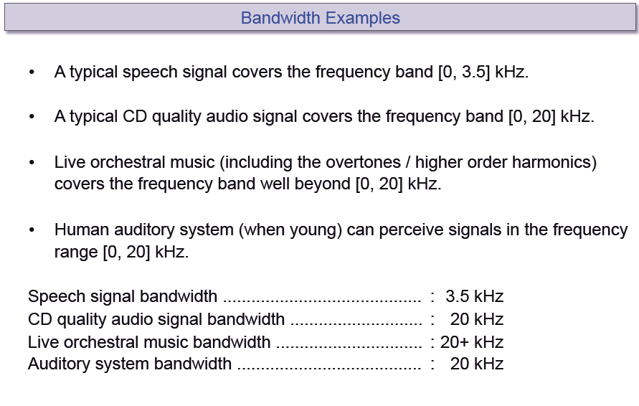

Slide 14
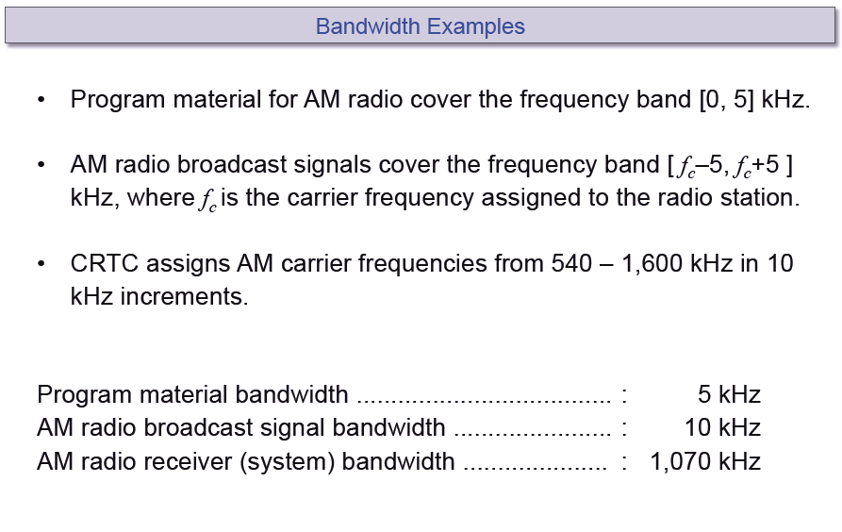

Slide 15
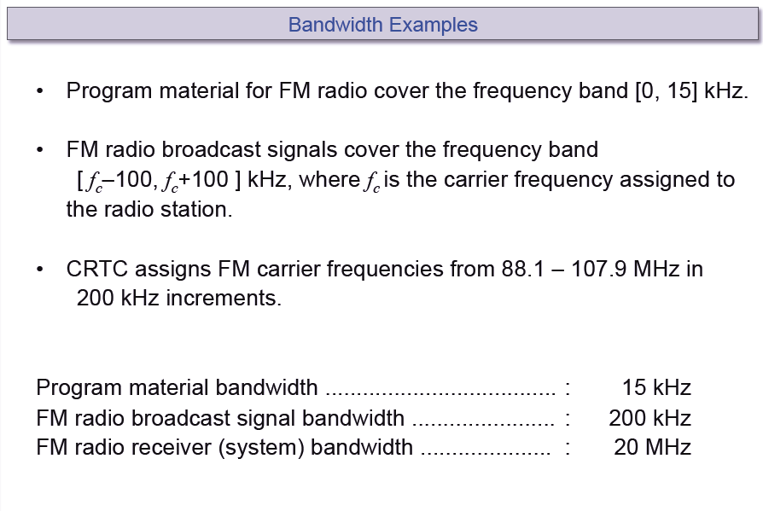

Slide 16
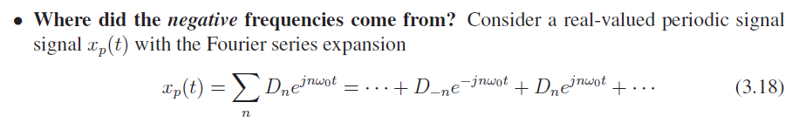
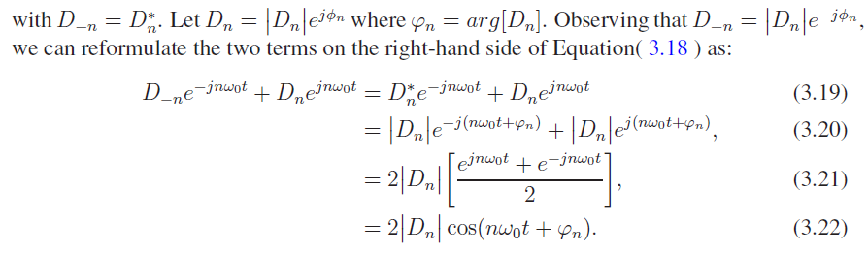

Slide 17
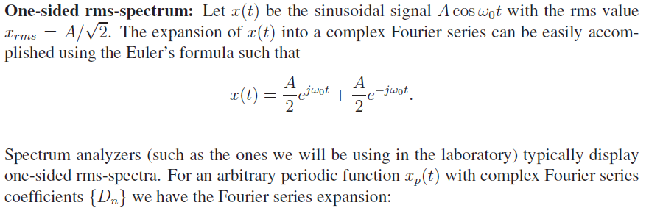
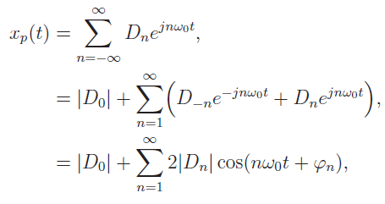

Slide 18
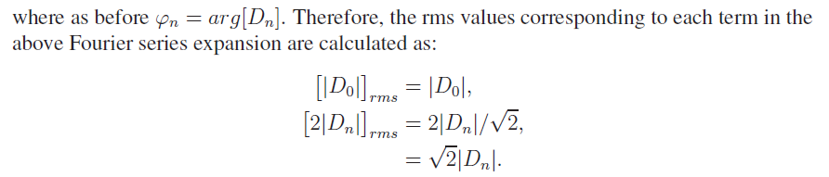
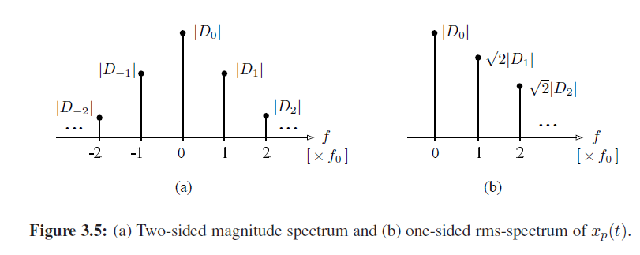

Slide 19
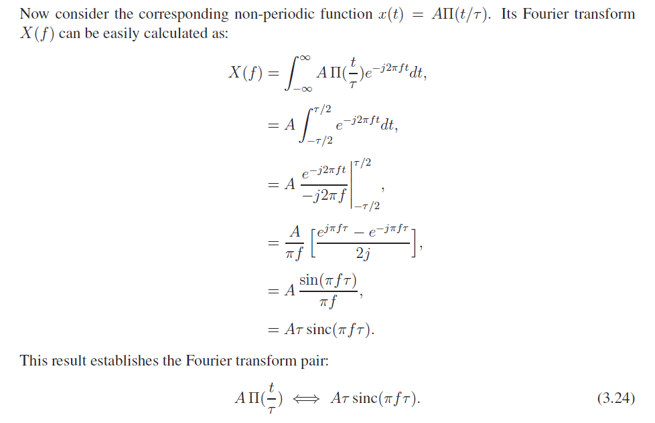

Slide 20
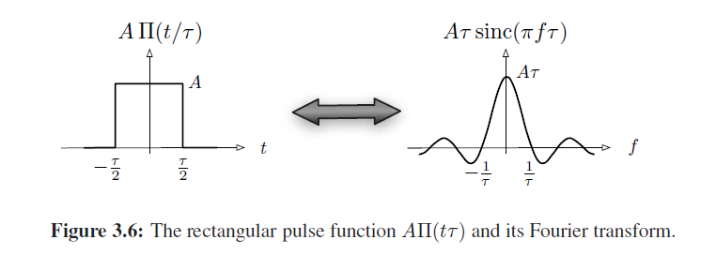
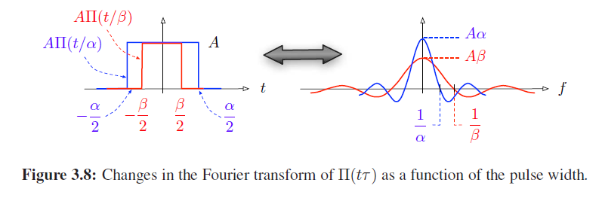

Slide 21
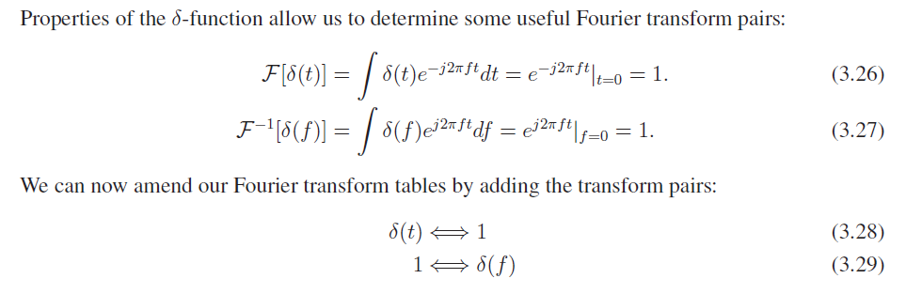

Slide 22
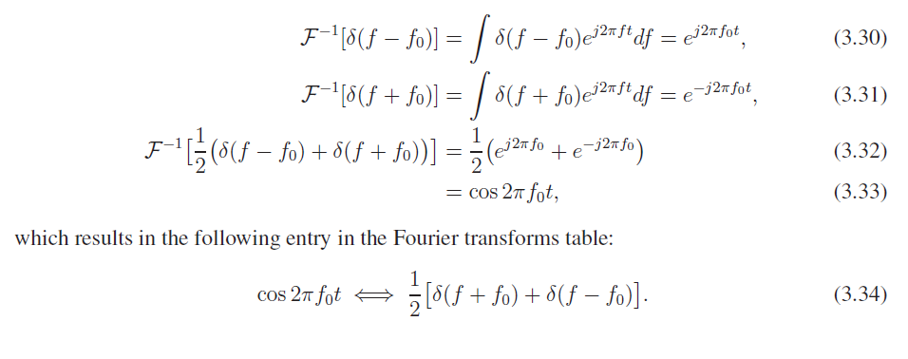
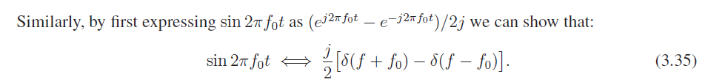

Slide 23

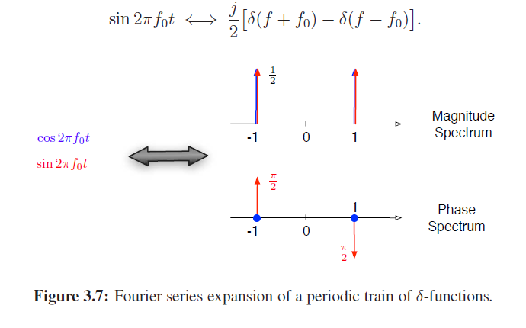

Slide 24
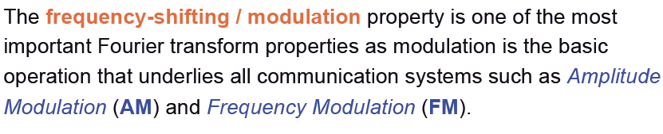


Slide 25
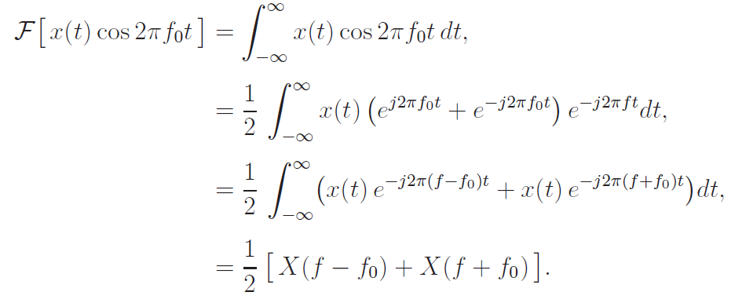

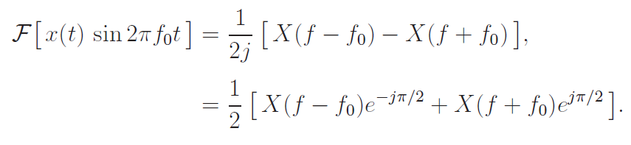

Real Frequency Shifting (Modulation) Properties

Slide 27
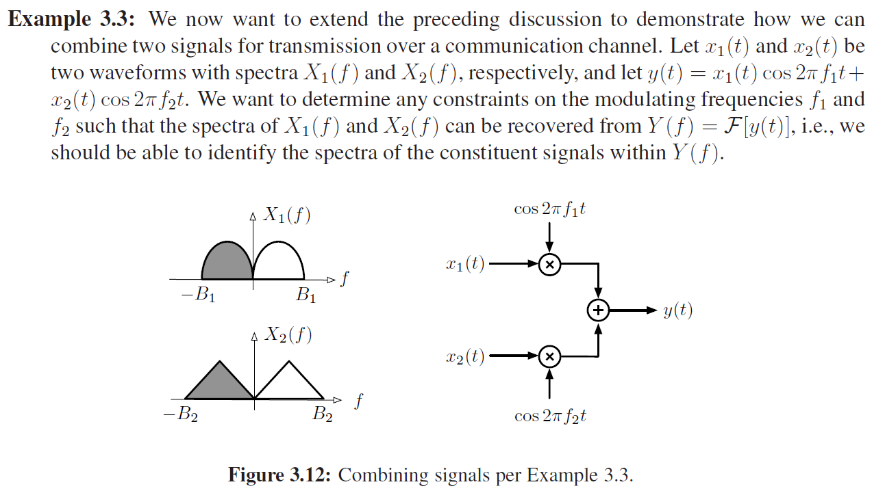

Slide 28
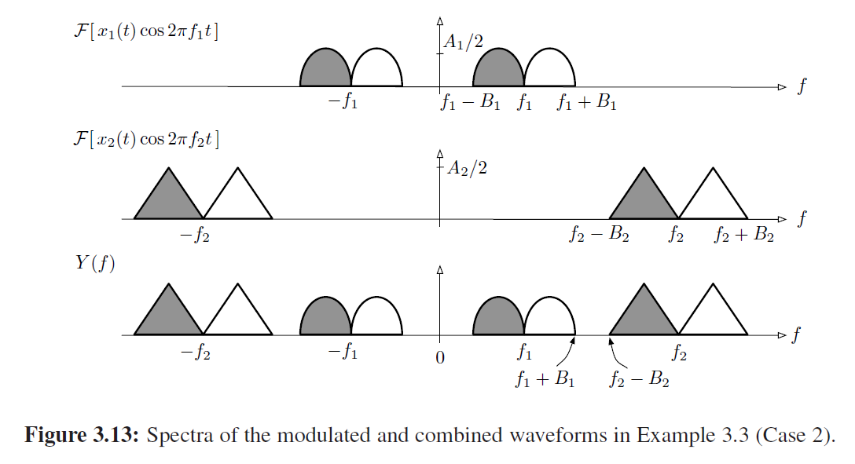


Slide 29
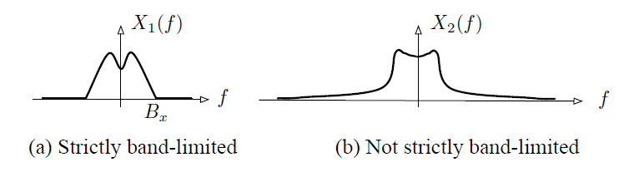
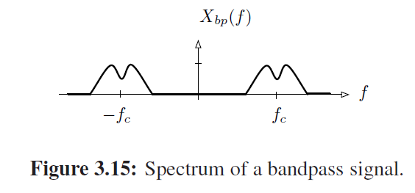
Spectrum of baseband Signals

Slide 30


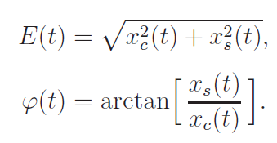
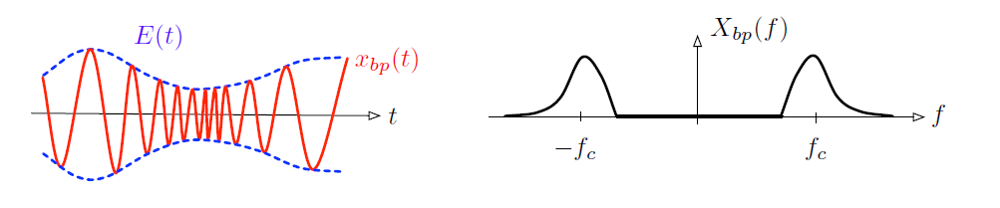
In general a bandpass signal can be written as,
Slowly varying envelope
Slowly varying phase (freq.)

Slide 31
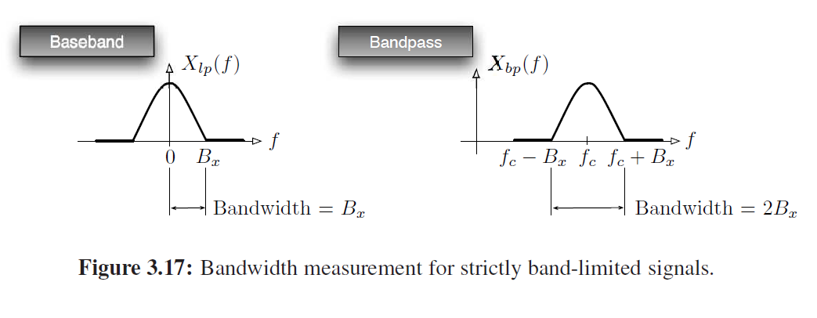
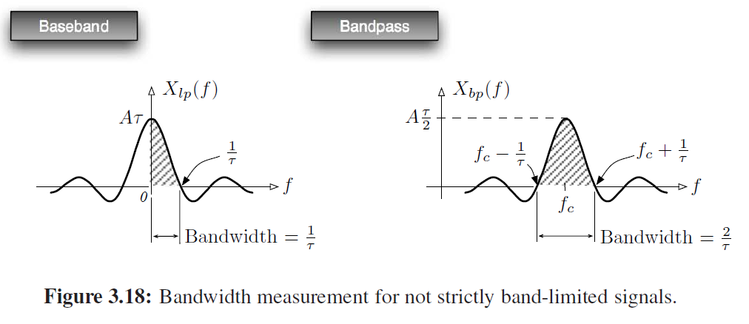


Slide 32

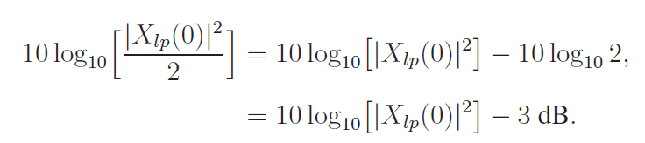
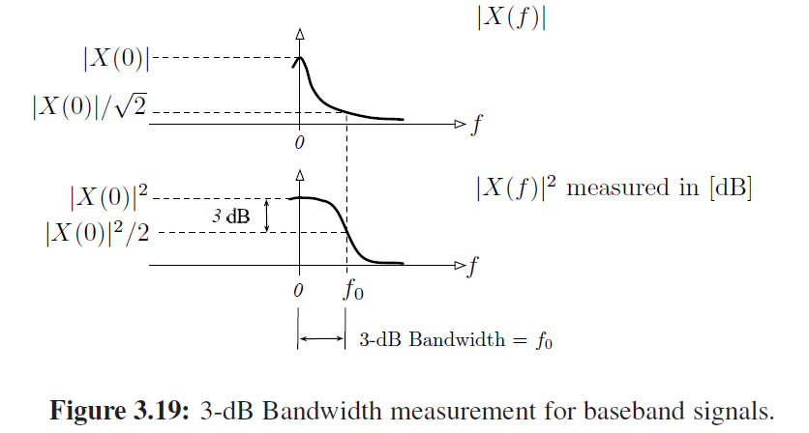

Slide 33
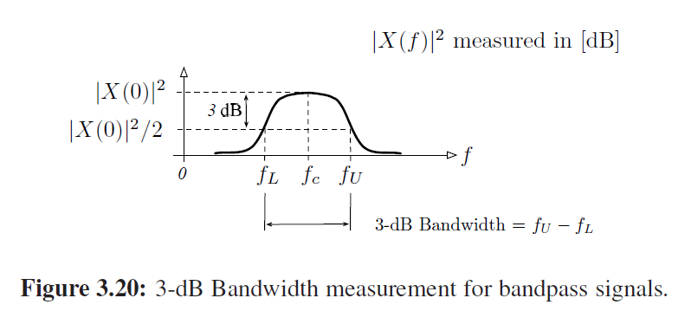

Slide 34
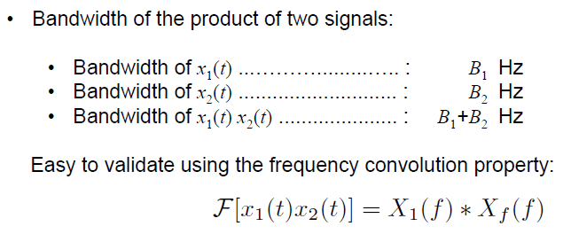
Bandwidth and Duration
The bandwidth and time-duration of a signal are inversely related and cannot be independently altered.

Slide 35
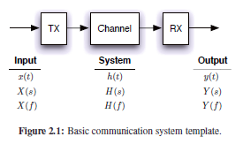



Basic Communication System
Channel – Linear Time Invariant (LTI) System
$$y\left(t\right)=h\left(t\right)∗x(t)$$
$$Y\left(s\right)=H(s)X\left(s\right)$$
h(t): Impulse response of the LTI system
H(f): Frequency Response of the LTI system
H(s): Transfer function of the LTI system
$$Y\left(f\right)=H\left(f\right)X(f)$$

Slide 36
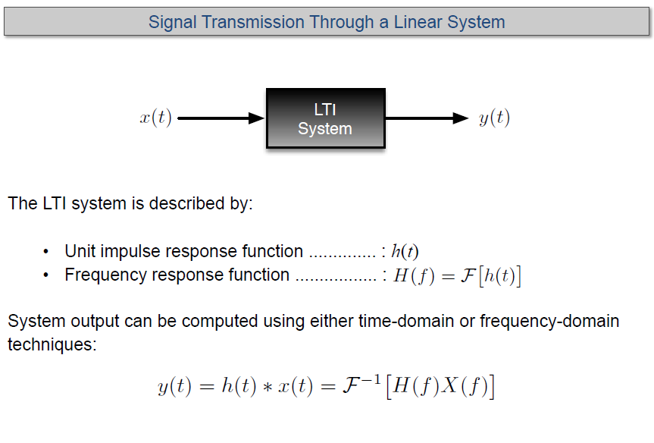

Slide 37
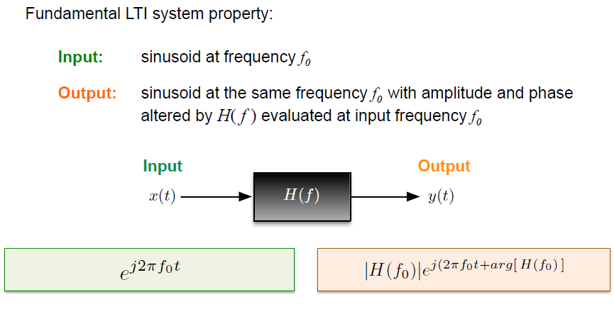

Slide 38
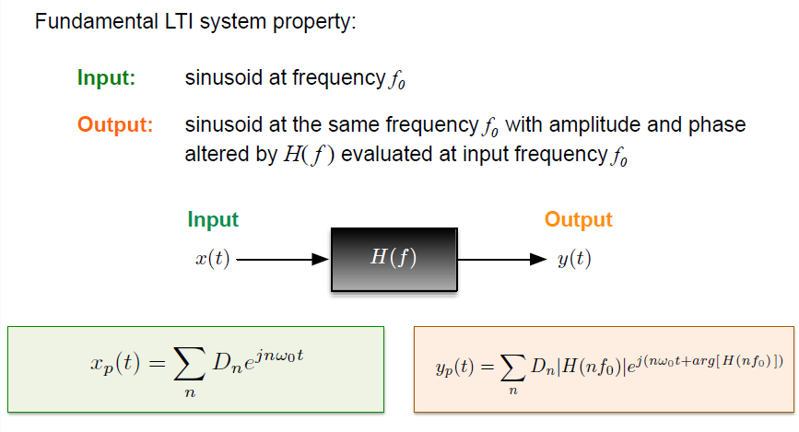

Slide 39
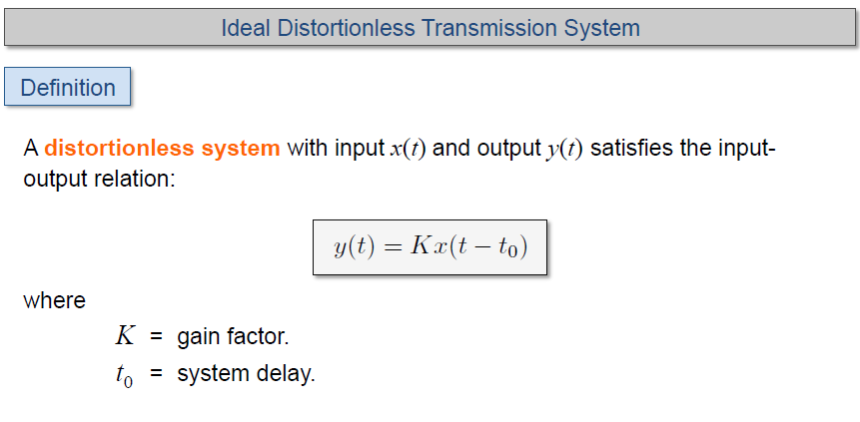
Distortion Less Transmission

Slide 40


Slide 41


Slide 42


Slide 43


Slide 44


Slide 45


Slide 46


Slide 47


Slide 48


Slide 49


Slide 50


Slide 51


Slide 52


Slide 53


Slide 54


Slide 55


Slide 56


Slide 57


Slide 58


Slide 59


Slide 60


Slide 61


Slide 62


Slide 63


Slide 64


Slide 65


Slide 66


Slide 67


Slide 68


Slide 69




Slide 70


Slide 71


Slide 72


Slide 73


Slide 74



LTI System Response
$$x\left(t\right)=A\sin{(2πf_{o}t)}$$
H_{F}(f)
Amplitude response multiplies.
Phase response is additive.

