Slide 1
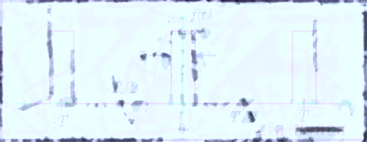
ELE 635 Chapter 2
Signals and Systems: A Brief Review
Xavier Fernando
Spring 2015

Slide 2
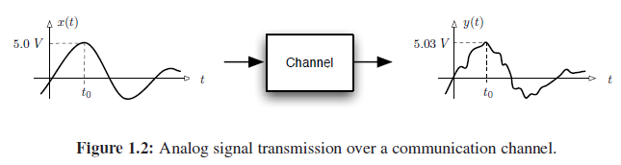
Signals and Systems
Signal is a set of data/information. In this course we consider only signals that are functions of time.
  Examples: current, voltage, voice, video
Signals are processed by systems.
  Examples: Communication channel, wire, amplifier

Slide 3
Signal Classification
Continuous and discrete time
Analog and digital signal
Periodic and aperiodic signal
Deterministic and probabilistic signal
Energy and power signals

Slide 4
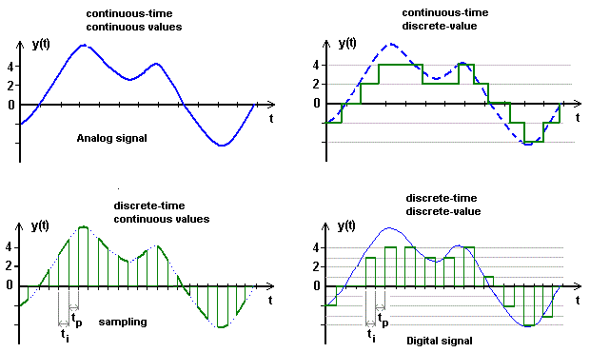
Continuous and Discrete

Slide 5
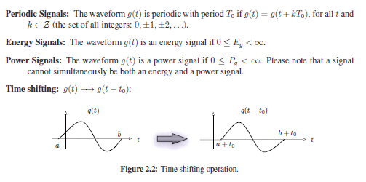
Classification of Signals
*Remember (t+t_{o}) will advance the signal which may result only in non-causal scenarios

Slide 6
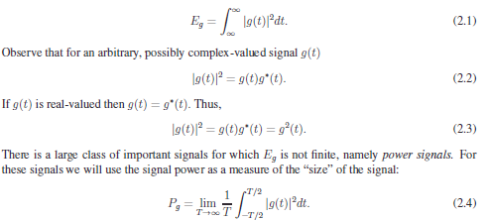
Signal Measures
Signal Energy
Signal Power
= (rms value)²
Example1: Find the power/energy of g(t) = 2e^{(-t/2)} ; t > 0
Example2: Find the power/energy of g(t) = C cos(ω_{o}t+θ)
Example3: Find the power/energy of g(t) = C₁ cos(ω₁t+θ₁)+ C₂ cos(ω₂t+θ₂)
Example3: Find the power/energy of g(t) = De^{jωot}

Slide 7
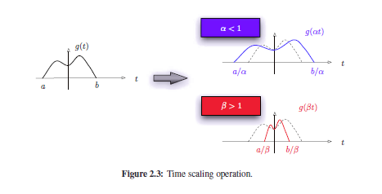
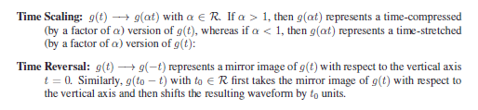
Time Scaling

Slide 8
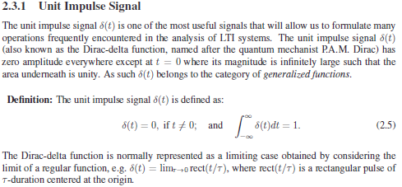
Impulse Signal

Slide 9

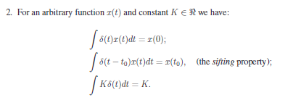

Slide 10
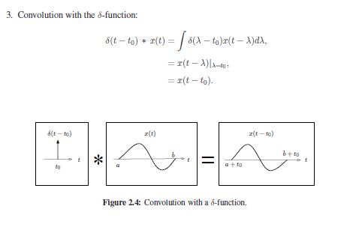

Slide 11
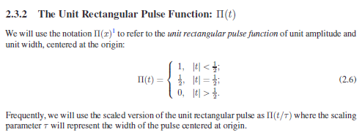
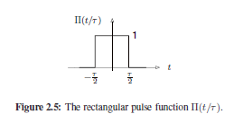
Rectangular Pulse Function
*It is also represented by rect(t)

Slide 12
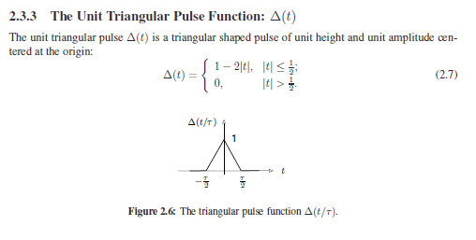
Triangular Pulse

Slide 13
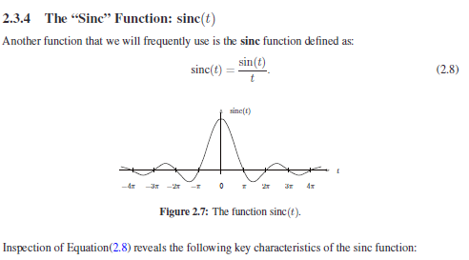
The ‘Sinc’ Function

Slide 14
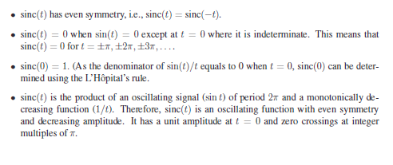
The ‘Sinc’ Function

